Slide 1
Header
Congenital and Acquired Hemolytic Anemias
Michael R. Jeng, MD
Subhead

Slide 2
Michael R. Jeng, MD
NO FINANCIAL DISCLOSURES

Slide 3
1. Red blood cell biology 2. Hemolytic anemia: definition, assessment 3. Approach to diagnosis 4. Microangiopathic hemolytic anemias 5. Congenital hemolytic anemias A. membrane defects B. enzyme deficiencies C. Hemoglobin abnormalities 6. Acquired hemolytic anemias A. Immune B. Non-immune

Slide 4
1. Red Cell Biology
Red blood cells are made in the bone marrow (spleen, liver)
Biconcave, anuclear, viscoelastic, self-sealing,
8 micron in size, squeezes through 2 micron size spaces and 3 micron vessels
Normal red blood cell lifespan = 120 days
Old cells typically removed by spleen
Approx. 1-2% of red cells are lost and replaced daily

Slide 5
1. Red Cell Biology
Red cell structure
Biconcave, acellular
Red cell membrane
Under membrane, has a flexible, fluid cytoskeleton
Mutations affected vertical connection: spherocytosis
Mutations with horizontal connection: elliptocytosis, ovalocytosis
ankrin
Band 3
Alpha spectrin
Beta spectrin

Slide 6
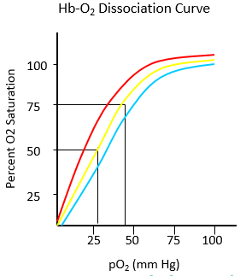
1. Red Cell Biology
Red cell functions: Deliver oxygen and energy to tissues
OXYGEN:
2,3 BPG (bisphosphoglyceric acid) aka 2,3 DPG (diphosphoglyceric acid)
Binds to unoxygenated hemoglobin
Increased levels promote oxygen delivery
Increased with chronic anemias
Oxygen desaturation curve:
pH, 2,3 DPG, temperature

Slide 7
1. Red Cell Biology
Energy from glycolysis: extracts energy from glucose (10 steps)
Glucose
Hexose Monophophate Shunt (G6PD produces Glutathione)
Glucose-6- phosphate
Fructose-6- phophate
Fructose 1,6 phosphate
Glyceraldehyde 3 phosphate
1,3 Glyceraldhyde bisphosphate
3 Phosphoglycerate
Pyruvate Kinase (forms ATP)
2 Phosphoglycerate
Phosphoenopyruvate
Pyruvate

Slide 8
1. Red cell biology
Erythrocytosis:
Regulated by erythropoietin, hormone made by kidney
Increased erythropoietin production with hypoxia
Production of red blood cells leads to detection of immature RBCs in peripheral blood
*In peripheral blood, young red blood cells can be detected through supravital staining = reticulocytes
Supravital staining: New methylene blue, Brilliant cresyl blue (stain for ribosome particles)

Slide 9
2. Hemolytic anemia
DEFINITION: Early destruction or rupture of red cells
Red cells can be broken apart through:
Extrinsic factors Intrinsic Factors
MICROANGIOPATHIC HEMOLYTIC ANEMIAS
Shearing in small vessels from fibrin and platelet microthrombi
Antibodies – extravascular hemolysis
Mechanical shearing: heart valves, March hemoglobinuria
Medications
Red cell membrane abnormalities
Unstable hemoglobins (sickle cell, thalassemias)
Oxidative Damage: enzyme abnormalities
Inability to protect from oxidative stress

Slide 10
2. Hemolytic anemia
Clinical features of acute anemia:
Fatigue
Respiratory distress
Tachycardia; Cardiac failure
Pallor
Jaundice/icterus
Dark urine – intravascular hemolysis
Hepatomegaly
Splenomegaly

Slide 11
2. Hemolytic anemia – clinical pearl
Aplastic Crisis:
All chronic hemolytic conditions are at risk for Aplastic Crisis
Usually due to viral suppression (PARVO B19)
Cessation in erythrocytosis for 7-10 days – profound reticulocytopenia
Leads to profound anemia
Treatment:
simple red cell transfusion
Usually resolves after single transfusion

Slide 12
2. Hemolytic anemia – work up
Evidence of increased red cell production
CBC: Hgb, Hct, RDW, Reticulocyte
Evidence of red cell destruction/hemolysis
Red cell morphology, Microangiopathy, Rouleau, spherocytes
T/D bili – unconjugated hyperbilirubinemia
Urinalysis: hemoglobinuria
Haptoglobin
Plasma Free hemoglobin
Lactate Dehydrongenase (LDH)

Slide 13
2. Hemolytic anemia
Release red blood cell contents
Hemoglobin (metabolism)
Hemoglobin is converted to unconjugated bilirubin
Liver conjugates bilirubin (uridine disphosphate-glucuronosyltransferase-1A1 (UGT1A1)
mutations lead to Gilbert’s Syndrome, Crigler Najar, Dubin- Johnson
(Elevated conjugated bilirubin)
Conjugated bilirubin = water soluble and can be excreted in stool
conjugated bilirubin
EXCRETION into intestine via biliary tree
Hemoglobin
released
Heme metabolized to
unconjugated bilirubin
LIVER
Red Blood Cell
Liver enzymes conjugate bilirubin (becomes water soluble)

Slide 14
2. Hemolytic anemia
Lactate dehydrogenase (LDH)
ubiquitous tissue enzyme.
Released with tissue damage
Increases with RBC destruction
Hemoglobin: oxidative stress/tissue damage
Free hemoglobin can cause oxidation/oxidative damage
Scavengers: haptoglobin
Binds plasma free hemoglobin, inhibits oxidation
Barcellini W, Fattizzo B. Dis Markers, 1-7, 2015.

Slide 15
2. Hemolytic anemia
SUMMARY of Biomarkers used to determine hemolysis
LDH- increased
Haptoglobin – decreased
Unconjugated bilirubin – increased
Reticulocyte - increased

Slide 16
3. Approach to diagnosis
HEMOLYSIS
MICROANGIOPATHIC HEMOLYSIS
NON-MICROANGIOPATHIC HEMOLYTIC ANEMIA
ACQUIRED
intrinsic
extrinisic
CONGENITAL
CONGENITAL
ACQUIRED
CONGENITAL
ACQUIRED

Slide 17
3. Approach to diagnosis
Microangiopathic Hemolysis
Caused by shearing of red cells in small vasculature
They are broken apart from microthrombi (fibrin strands and platelets)
Evidence of schistocytes on blood smear
Intravascular hemolysis
Red blood cells are hemolyzed inside of the blood vessels
Extravascular hemolysis
Red blood cells are hemolyzed through destruction by macrophages as they go through spleen or liver
schistocytes
Red cell
Platelet/fibrin thrombi

Slide 18
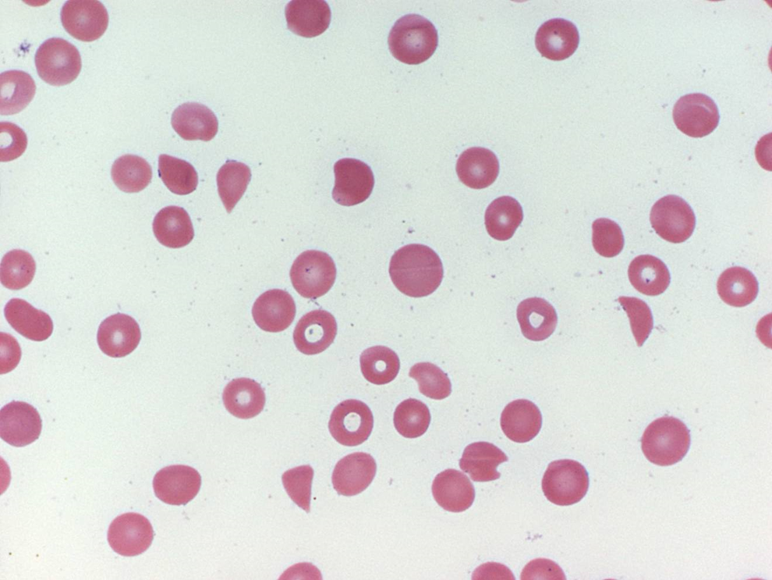
4. Microangiopathic Hemolytic Anemias
A. Thombotic Thrombocytopenic Purpura (TTP)
B. Hemolytic Uremic Syndreme (HUS)
C. Atypical HUS
D. Secondary MHA
Autoimmune vasculopathy
Drug-induced
Disseminated intravascular coagulopathy
Schistocytes

Slide 19
4. Microangiopathic Hemolytic Anemias
A. Thrombotic Thrombocytopenic Purpura (TTP)/Moschcowitz Syndrome
Classical pentad: prolonged fever
mental status changes
renal insufficiency
thrombocytopenia
microangiopathic hemolytic anemia
Pathophysiology:
Decreased activity of ADintegrin-like And Metalloprotease with ThromboSpondin type 13 (ADAMTS13) enzyme
ADAMTS13 cleaves von Willebrand factor
Decreased activity leads to ultra-high molecular weight VWF
This leads to platelet aggregation on endothelium, leading to shearing of RBC

Slide 20
4. Microangiopathic Hemolytic Anemias
A. Thrombotic Thrombocytopenic Purpura (TTP)
Diagnosis made by measuring ADAMTS13 activity
Detection of Ultra high molecular weight vWF
1. Congenital: mutations in ADAMTS13
(aka: Upshaw-Schulman Disease)
Treatment: plasma infusions regularly
2. Acquired: auto-antibodies to ADAMTS13 (inhibitors)
Steroids, plasmapheresis, plasma, anti-CD20

Slide 21
B. Hemolytic Uremic Syndrome (HUS)
4. Microangiopathic Hemolytic Anemias
Following bloody diarrheal episode
Often secondary to Ecoli 0157
Secondary to shiga toxin-induced endothelial cell injury – release of large VWF multimers – get MAHA
Treatment: Supportive care

Slide 22
C. Atypical HUS
4. Microangiopathic Hemolytic Anemias
Microangiopathic hemolytic anemia
Renal failure typical
No history of diarrheal disease
Pathophysiology:
chronic, uncontrolled activation of the complement system
Due to loss of function mutations in CHF, CHI, MCB, THBD genes, or gain of function mutations in C3 or CFB genes
LAB TESTING: C3, C4, CFH serology, CFI serology
Treatment: Anti-C5 antibody Eculizumab (recombinant, humanized, monoclonal Ig that targets C5)

Slide 23
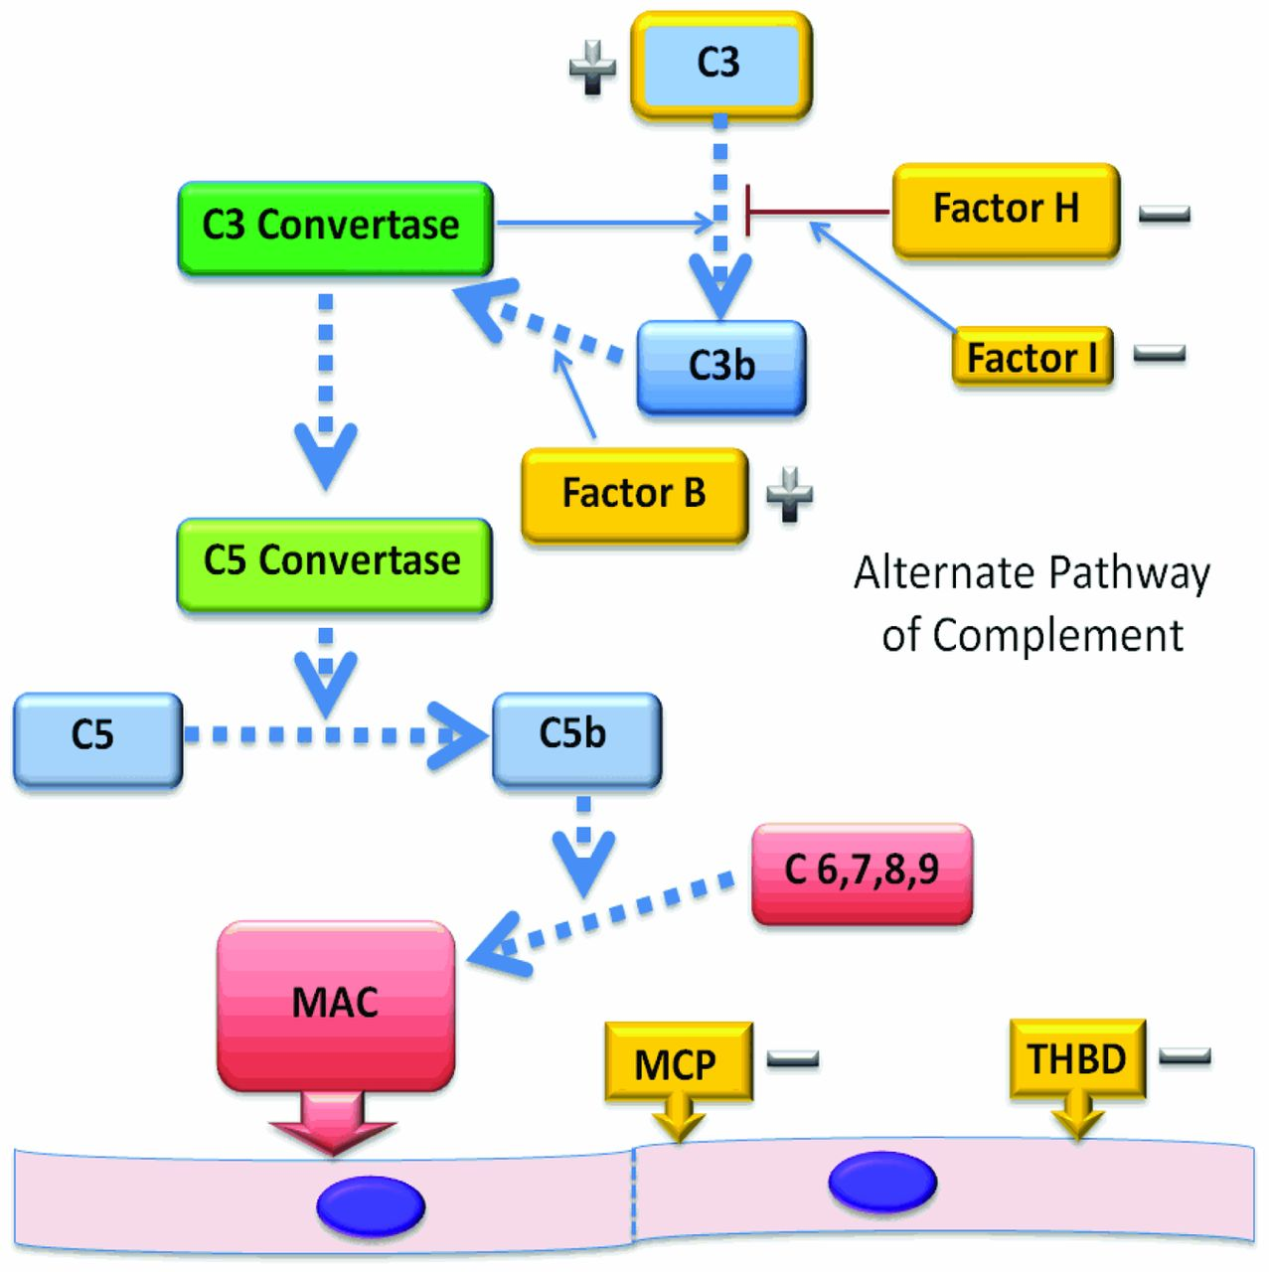
The AP begins with activation of C3 and leads to the assembly of the membrane attack complex as a mechanism of protection from infectious agents.
Rebuplished with permission of the American Society of Hematology, from ASH Education Book, Atypical haemolytic uremic syndrome: what is it, how is it diagnosed, and how is it treated?, Nester, et al, 2012, 1; permission conveyed through Copyright Clearance Center, Inc.
Notes:
The AP. The AP begins with activation of C3 and leads to the assembly of the membrane attack complex as a mechanism of protection from infectious agents. Dysregulation of this pathway in disease is most often by the loss of function of regulatory proteins and can lead to endothelial injury, platelet activation, and thrombosis. Regulatory genes (−) that have been shown to be mutated in aHUS are shown in gold. CFH, CFI, MCP, and THBD cooperate to regulate complement activation or inactivate endothelial cell surface-bound C3b, protecting endothelial cells from complement-mediated injury. C3 mutations affect the ability of C3 to bind to regulatory proteins and CFB mutations are gain-of-function mutations (+) that result in an increased stability of the C3 convertase.

Slide 24
D. Secondary Microangiopathic Hemolytic Anemia
4. Microangiopathic Hemolytic Anemias
Disseminated Intravascular Coagulation (DIC) from infection
Maternal Autoimmune Disease
Antiphospholipid abs
lupus
Drug-induced

Slide 25
5. Congenital hemolytic anemias
RBC Membrane defects
A. Hereditary Spherocytosis
B. Hereditary Elliptocytyosis
C. Hereditary Ovalocytosis
RBC Enzyme deficiencies
A. G6PD
B. Pyruvate Kinase
Hemoglobin defects
A. Sickle cell disease
B. Thalassemia
C. Unstable Hemoglobin Variants

Slide 26
5. Congenital hemolytic anemias: RBC Membrane defects: A. Hereditary Spherocytosis
Most common cause of non-immune hemolytic anemia
(especially N. Europeans, 1/2000)
Often diagnosed incidentally
Prolonged neonatal jaundice
Intermittent symptoms of hemolysis, especially with viral infections
Splenomegaly (extravascular hemolysis)
High MCHC (over 36)
Spherocytes on peripheral blood smear

Slide 27
5. Congenital hemolytic anemias: RBC Membrane defects: A. Hereditary Spherocytosis
Abnormalities of ankyrin, spectrin, Protein 4.2 or Band 3
Form a complex that holds cytoskeleton to lipid bilayer (vertical abnormality)
Ankryin abnormalities most common
Inheritance:
Autosomal dominant (majority 75%)
Autosomal recessive (most clinically severe, 25%)
Abnormalities in Beta spectrin also common Abnormalities in alpha spectrin are more severe
- high binding affinity to ankyrin - Made 3 fold more than beta spectrin
- Made three-fold less than alpha spectrin -usually autosomal recessive

Slide 28
Red blood cell lipid bilayer and cytoskeleton
Red cell membrane – lipid bilayer
Under membrane, has a flexible, fluid cytoskeleton
Mutations affected vertical connection: spherocytosis
Mutations with horizontal connection: elliptocytosis, ovalocytosis
ankrin
Band 3
alpha spectrin
Beta spectrin

Slide 29
5. Congenital hemolytic anemias: RBC Membrane defects: A. Hereditary Spherocytosis
Diagnosis:
Osmotic Fragility
Red Blood Cell lysis in different hypotonic NACL concentrations
HS patients have increased fragility
Eosin-5-maleimide
Binds normal red blood cells with Band 3 on lipid bilayer
Normal levels of Band 3 with ankryin, Protein 4.2, spectrin complex
Flow cytometry measures amount bound on RBC

Slide 30
5. Congenital hemolytic anemias: RBC Membrane defects: B. Hereditary Elliptocytosis
Abnormalities of ankyrin, spectrin, Protein 4.2 or Band 3
Southeast Asian, African, Mediterranean background
Horizontal defects – lead to elliptocyte shape
Range of clinical severity, most minimal hemolysis, Large spleen
Most are Autosomal Dominant
May have poikilocytosis at birth
Southeast Asian Variant: due to single Band 3 mutation
Only heterozygous state, homozygosity is lethal

Slide 31
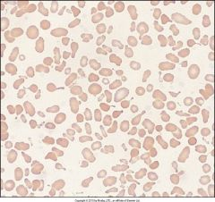
5. Congenital hemolytic anemias: RBC Membrane defects: C. Hereditary Pyropoikilocytosis
Inheritance of HE abnormality
Also spectrin heterodimer formation abnormality
Most are African American
Range of clinical hemolysis, many are asymptomatic
Hematology Images
by jessica-ucci9, May 2011 (Cram.com)

Slide 32
5. Congenital hemolytic anemias RBC Enzyme Deficiencies:
G6PD deficiency
Pyruvate Kinase deficiency
Pyrimidine 5′ nucleotidase deficiency

Slide 33
5. Congenital hemolytic anemias RBC Enzyme Deficiencies: A. G6PD deficiency
Background:
Hemoglobin and the rbc membrane are at constant risk for oxidant injury.
The red cell does not utilize the oxygen it carries and relies on glycolysis for energy.
Hemoglobin remains soluble: if oxidized, can become insoluble and thus lead to hemolysis
Iron in heme is ferrous (reduced state), Fe (II) in order to maximally carry oxygen. Ferric , Fe (III) does not carry oxygen and is called methemoglobin
G6PD is essential for maintaining a reducing environment in the red cell: glutathione
HEXOSE MONOPHOSPHATE SHUNT

Slide 34
1. Red Cell Biology
Energy from glycolysis: extracts energy from glucose (10 steps)
Glucose
Hexose Monophophate Shunt (G6PD produces Glutathione)
Glucose-6- phosphate
Fructose-6- phophate
Fructose 1,6 phosphate
Glyceraldehyde 3 phosphate
1,3 Glyceraldhyde bisphosphate
3 Phosphoglycerate
2 Phosphoglycerate
Phosphoenopyruvate
Pyruvate

Slide 35
5. Congenital hemolytic anemias RBC Enzyme Deficiencies: A. G6PD deficiency Hexose Monophosphate Pathway
Glucose-6-Phosphate
Dehydrogenase
Glucose-6-Phosphate
6 Phosphogluconate
Ribulose-5-Phosphate
Ribose-5-Phosphate
NADP
NADPH
Glutathione Reductase
GSSG
2GSH

Slide 36
5. Congenital hemolytic anemias RBC Enzyme Deficiencies: A. G6PD deficiency
X linked
Most common human enzyme defect
Meditarraneans, Africans, Southeast Asians, Middle East
There are approximately 160 mutations of G6PD
Many patients have only a decreased half life of the enzyme
Most patients are not hemolytic, unless exposed to oxidative stress (i.e. naphthalene, fava beans, sulfa drugs, etc. . . ..
Patients often have a history of prolonged hyperbilirubinemia in the newborn period, yet no hemolysis
Diagnosis:
Check G6PD activity
However, younger red cells have higher G6PD activity
Need to check when not hemolyzing

Slide 37
Consequences of Oxidation
Methemoglobin is Denatured Hemoglobin and Can Precipitate
Leads to Heinz Body formation in the RBC
This can help make the diagnosis of a RBC Enzyme abnormality

Slide 38
5. Congenital hemolytic anemias RBC Enzyme Deficiencies: A. G6PD deficiency Intrinsic Enzyme Defects: G6PD A- Variant is the Most Common
African-Americans variants
The clinically significant one and most common on is A-:
Only older RBC are affected by the abnormal enzyme activity
Oxidant exposure usually only causes abrupt but mild anemia (older cells only)
Drug precautions: pyridium, sulfa antibiotics, nitrofurantoin, dapsone

Slide 39
5. Congenital hemolytic anemias RBC Enzyme Deficiencies: A. G6PD deficiency Intrinsic Enzyme Defects: the Mediterranean Variant is the Second Most Common and is More Severe
Mediterranean Variant
clinically more severe because affects all ages of RBC
severe hemolysis which might require transfusion
extravascular and intravascular hemolysis can occur
hemolysis usually occurs with provocation, medications or infection, and is
not spontaneous

Slide 40
5. Congenital hemolytic anemias RBC Enzyme Deficiencies: B. Pyruvate Kinase Deficiency
Pyruvate Kinase: takes pyruvate formed from glycolysis, and helps to use it for energy by generating ATP
Deficiency in Pyruvate Kinase: 1/20,000
Due to deficiency, RBCs have less energy, and thus shortened lifespan
Extravascular hemolysis: Treatment splenectomy
Pyruvate
Pyruvate Kinase
Phosphoenolpyruvate
ADP
ATP

Slide 41
5. Congenital hemolytic anemias RBC Enzyme Deficiencies: C. Pyrimidine-5-nucleotidase deficiency
Pyrimidine-5-nucleotidase participates in degradation of RNA
Deficiency leads to pyrimidine left in the RBCs
These pyrimidines are toxic and lead to hemolytic anemia
On staining, basophilic stippling
Autosomal recessive inheritance
Lead directly inhibits Pyrimidine-5-nucleotidase
No treatment available

Slide 42
5. Congenital hemolytic anemias Hemoglobin Defects: Beta Globin Point Mutations
A. Sickle Cell Disease:
Hb S (sickle hemoglobin)
Single amino acid substitution in beta globin chain
Glutamine to valine at codon 6
deoxy HbS polymerizes, is insoluble, and changes the shape and deformability of the rbc
heterozygous (AS) usually asymptomatic; AS is protective against malaria
homozygous (SS) and HbSBthal leads to severe anemia, vasoocclusion
Hb C
Glutamine to lysine at codon 6
Hb SC disease can cause severe vasoocclusion but less anemia
Hb CC can crystallize, cause hemolysis and splenomegaly
highly protective against malaria
Diagnostic tests: Hb electrophoresis, HPLC

Slide 43
5. Congenital hemolytic anemias: Hemoglobin Defects B. Thalassemias: Mutations lead to a quantitative deficiency of a globin chain. Imbalance of globin chains leads to unstable hemoglobins and hemolysis C. Hemoglobin variants. Most are clinically silent. Those that are unstable, and lead to hemolysis are worth remembering. Most common unstable: Hgb Koln Oxidized easily, and thus lead to chronic hemolysis. Increased hemolysis with oxidative stressors. Hgb Zurich:

Slide 44
6. Acquired hemolytic anemias
Autoimmune
A. Cold
B. Warm
C. Paroxysmal Cold Hemoglobinuria - Donath Landsteiner
Alloimmune
A. Hemolytic Disease of the Newborn
Non-Immune Extrinsic Hemolysis
Splenomegaly
Medications
Physical Destruction
March Hemoglobinuria
Waring Blender Effect

Slide 45
6. Extrinsic Hemolytic Anemia: Autoantibody Mediated
IgG is the most common type
IgM (binds transiently, fixes complement) detected by complement activation on surface. No direct measure of IgM
C3 is detected instead of IgM
IgG and C3 are detected by the Direct Coombs test, or Direct Antiglobulin Test (DAT)
The Indirect Coombs, or Indirect Antiglobulin Test (IAT), detects antibody in the serum
Peripheral smear: spherocytes and, if adequate marrow response,
Reticulocytes, possibly Rouleaux

Slide 46
6. Extrinsic Hemolytic Anemia: A. Warm agglutinin disease Autoantibody IgG Mediated
IgG mediated Hemolysis
Often best agglutinates at Warm temperatures, thus called Warm AIHA
Typically is extravasacular: cells are coated with antibody, removed by spleen or liver
Thus, usually no hemoglobinuria
Treatment: steroids, Ivig, immunosuppression, anti-CD20 antibody, splenectomy

Slide 47
6. Extrinsic Hemolytic Anemia: B. Cold Agglutinin Disease Autoantibody IgM Mediated
IgM mediated Hemolysis
IgM is a much larger antibody, can bind several red cells
Often best agglutinates at Cold temperatures, thus called Cold AIHA
Typically is intravasacular: cells directly hemolysed by the IgM antibodies
May be hemoglobinuria
Treatment: Supportive care, keeping patient warm, plasmapheresis

Slide 48
6. Extrinsic Hemolytic Anemia: C. Paroxysmal Cold Hemoglobinuria (PCH)
IgG mediated extravascular hemolysis, often following a viral illness
Often occurs in children, median age 5 years. 30-40% of AIHA in children due to PCH
Polyclonal IgG directed at the P-antigen
Often best agglutinates at Cold temperatures, but then fixes complement at warmer temperatures, and thus hemolyzes at warm temperatures
Referred to as Donath-Landsteiner antibody
Requires thermolabile testing to detect (first at 4C, and then 37C to see hemolysis).
Treatment: Supportive care, keeping patient warm, steroids

Slide 49
6. Extrinsic Hemolytic Anemia: Alloimmunization Hemolytic Disease of the Newborn (HDN)
Maternal antibodies from mother cross placenta into infant: red cell phenotype differences
Typically due to Rh incompatibility, but also Kell, Duffy, Kidd, MNS families
Rh positive fetus/Rh negative mother (note: almost all Asians are Rh Positive)
If ABO incompatible, then less likely chance for Rh disease to develop (clearance of infants RBCs)
1/300-1/600 affected worldwide
Sensitized with each pregnancy – Mothers should get anti-Rh antibody
ABO incompatibility usually leads to a very mild, non-clinically significant hemolysis. These antigens are weak in early infancy.
Treatment: Treat hyperbilirubinemia, transfusion, exchange transfusion. Treatment of the mother for subsequent pregnancies

Slide 50
6. Extrinsic Hemolytic Anemia Non-Immune
Splenomegaly and/or Hepatomegaly
Mechanical Heart Valves (“Waring Blender”)
Left ventricular assist devices (LVAD)
Microvascular Compression (March hematuria - marathon runners)
Fresh Water Drowning (osmotic stress)
Notes:
Note: we will not be reviewing TTP/HUS in this lecture. This will be covered in your lab.

Slide 51
References
Defects in erythrocyte membrane skeletal architecture. Adv Exp Med Bio 2015;842:41 -59 Steiner LA, Gallagher PG. Erythrocyte disorders in the perinatal period. Semin Perinatol. 2007;31(4):254-61. Lowe EJ, Werner EJ. Thrombotic thrombocytopenic purpura and hemolytic uremic syndrome in children and adolescents. Semin Thromb Hemost. (2005)31(6):717-730/ Jeanne E. Hendrickson J, Meghan Delaney M. Hemolytic Disease of the Fetus and Newborn: Modern Practice and Future Investigations. Transfusion Medicine Reviews 2016;30:159-164.

