Slide 1

Julie R. Park, MD
Seattle Children’s Hospital
University of Washington School of Medicine

Slide 2

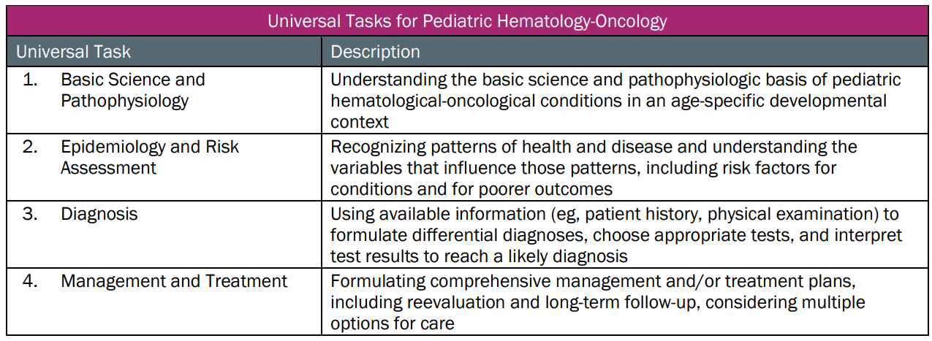
This talk will follow the topical structure suggested by the ABP
Copyright © 2019 by ASPHO

Slide 3
Neuroblastic, Pheochromocytoma and Paraganglioma, Renal Tumors of Childhood
Basic Science and Pathophysiology
Epidemiology and Risk Assessment
Diagnosis
Management and Treatment
Copyright © 2019 by ASPHO

Slide 4
Neuroblastic Tumors
Basic Science and Pathophysiology
Epidemiology and Risk Assessment
Diagnosis
Management and Treatment
Copyright © 2019 by ASPHO

Slide 5
Neuroblastomic Tumors
Embryonal malignancy originating from neural crest tissue of the sympathetic nervous system
Category encompasses a spectrum of tumors characterized by varying levels of neuronal differentiation: ganglioneuroma, ganglioneuroblastoma and neuroblastoma
Heterogenous clinical course ranging from spontaneous regression to highly aggressive disease with fatal outcome
Copyright © 2019 by ASPHO

Slide 6
Pathologic features of neuroblastic tumors
Small, round and blue tumor cells
Homer-Wright rosette patterns: tumor cells around neuropil
Ganglioneuroma, ganglioneuroblastoma, neuroblastoma
  Varying degree of neuronal maturation
  Varying degree of mitosis and karyorrhexis
  Varying degree of Schwannian stroma intermixed with tumor cells
Copyright © 2019 by ASPHO

Slide 7
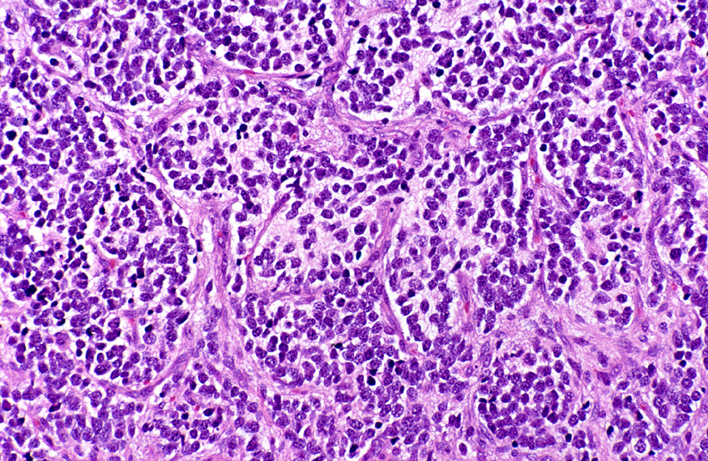
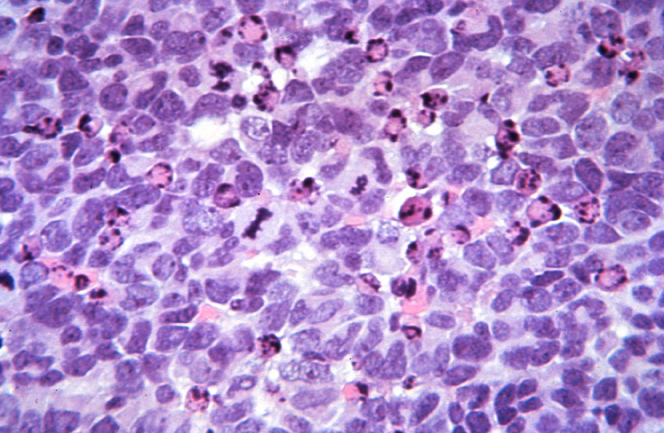
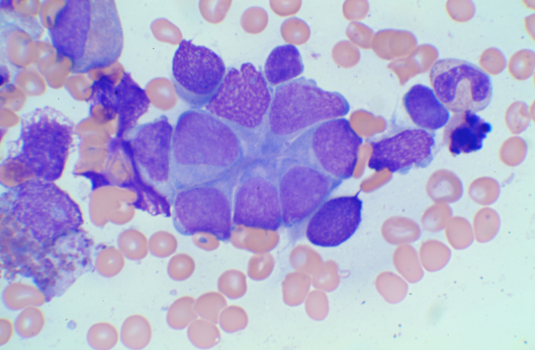
Neuroblastoma pathology
Poorly differentiated histology, Low MKI
Differentiating histology, Low MKI
Undifferentiated histology,
High MKI
Homer-Wright rosette patterns
Copyright © 2019 by ASPHO
Notes:
age-appropriate evaluation of histologic indicators (grade of neuroblastic differentiation, mitosis-karyorrhexis index

Slide 8
Molecular driver of disease
Aberrant telomere maintenance leads to aggressive phenotype
  MYC driven tumors: NMYC amplification, NMYC overexpression and MYC overexpression
    20% of neuroblastomic tumors
  Inactivating mutations in ATRX (alpha thalassemia/mental retardation syndrome X linked) chromatin remodeling gene
    Exclusive of MYCN amplification
    Activates alternative lengthening of telomeres (ALT) pathway
    Majority are > 5 years of age
  Activating rearrangements in TERT (telomerase reverse transcriptase)
    Exclusive of MYCN and ATRX mutations
    13% of neuroblastomic tumors
Copyright © 2019 by ASPHO

Slide 9
Somatic genetic profiles
Two broad patterns of chromosomal changes
  whole chromosomal gains, lack of structural changes and hyperdipolid DNA content
  segmental chromosomal aberrations (SCAs) and diploid DNA content
Tumors with whole chromosomal abnormalities are associated with an excellent outcome
Tumors with SCA/diploid have an inferior outcome
  Hypothesized to result from altered telomere lengthening
Copyright © 2019 by ASPHO

Slide 10
Somatic: SCA and loss of genetic material
Chromosome 1p36
  detected in 23-30% of tumors
  associated with MYCNA
Chromosome 11q23
  detected in 30 - 40% of tumors
  associated with TERT rearrangement and ATRX mutation
Copyright © 2019 by ASPHO

Slide 11
Additional somatic mutations
Aberrations of ALK (ch2p23)
  Amplification detected in 2-3% of NB tumors
  Activating aberrations in 8-10% of NB
ch17q gain (specific gene not known)
  detected in >60% of tumors
AT-rich interactive domain 1A and B ( ARID1a/1b ) deletions and point mutations
  chromatin remodeling proteins
p53, PTPN11, and genes involved in Ras/MAPK signaling (<5% tumors)
Copyright © 2019 by ASPHO

Slide 12
Neuroblastic Tumors
Basic Science and Pathophysiology
Epidemiology and Risk Assessment
Diagnosis
Management and Treatment
Copyright © 2019 by ASPHO

Slide 13
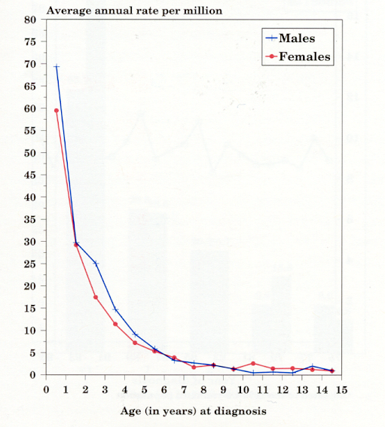
Epidemiology of neuroblastic tumors
Sympathetic nervous system age-specific incidence rates by sex, all races
SEER, 1976-84 and 1986-97
8-10% of all pediatric cancers
Incidence 10.5/million children/year (650 cases in NA annually)
2nd most common solid neoplasm in childhood
Most common solid tumor in children < 1 yr
Median Age 19 months
Male Predominance (1.2:1)
No geographic variation in incidence
African Americans and Native Americans more likely to have poor prognostic features and poor outcomes
FROM: NCI SEER Pediatric Monograph, Cancer Incidence and Survival among Children
and Adolescence: United States SEER Program 1975-1995 p.67.
Copyright © 2019 by ASPHO

Slide 14
Genetic predisposition
Familial neuroblastoma (1-2% of NB diagnoses)
  Anaplastic lymphoma kinase (ALK) germline mutation
  PHOX2B germline mutation
    Neurocristopathy syndrome: Central hypoventilation, Hirshprung’s, NBL
Neurofibromatosis
Beckwith-Wiedemann (WT2); Li-Fraumeni (TP53); Noonan’s (PTPN11)
Germline deletion at the 1p36 or 11q14-23 locus
Genome wide association studies identified germline genetic variants that may predispose to NB
Copyright © 2019 by ASPHO

Slide 15
Prognostic features of neuroblastic tumors
Age (North America: ≥ 18 months)
  Age < 1 year: 5 yr OS 90%.
  Age 1 to 4 years: 5 yr OS 68%.
  Age 5 to 9 years: 5 yr OS 52%.
  Age 10 to 14 years: 5 yr OS 66%
Stage of disease
Pathology
Presence of unfavorable genetic aberrations
  MYCN amplification
  Segmental chromosomal aberration/Diploid
Copyright © 2019 by ASPHO

Slide 16
International Neuroblastoma Staging System
Copyright © 2019 by ASPHO

Slide 17
International Neuroblastoma Risk Group Staging System (INRGSS)
Stage | Description
L1 | Localized tumor not involving vital structures (without image defined risk factors (IDRFs) and confined to one body compartment
L2 | Locoregional tumor with presence of one or more image defined risk factor
M | Distant metastatic disease (except MS)
MS | Metastatic disease in children less than 18 months with disease confined to skin, liver and/or bone marrow
IDRF:
Tumor encasing major vessels in neck/thorax/abdomen, encasing brachial plexus, extending across compartments, invading porta hepatis or renal pedicle, infiltrating organs, compressing spinal cord
Reprinted with permission. © (2009) American Society of Clinical Oncology. All rights reserved. Cohn, S et al: J Clin Oncol, Vol.27 (2), 2009: 289-297.
Copyright © 2019 by ASPHO

Slide 18
International Neuroblastoma Pathology Classification (INPC)
Tumor morphologic features prior to therapy
  Amount of Schwannian stroma
  Degree of tumor neuroblastic maturation
  Mitosis-karyorrhexis index (MKI) of the neuroblastic cells
Evaluated within the context of patient’s age (< 18 mos; 18 mos – 5 yr and > 5 yr
Categories: Favorable vs Unfavorable
  Favorable: increasing age must correlate with increasing differentiation; low MKI
INPC is an independent prognostic variable for outcome
  Poor prognosis associated with less neuronal differentiation (poorly or undifferentiated)
  Poor prognosis associated with high MKI
Copyright © 2019 by ASPHO

Slide 19
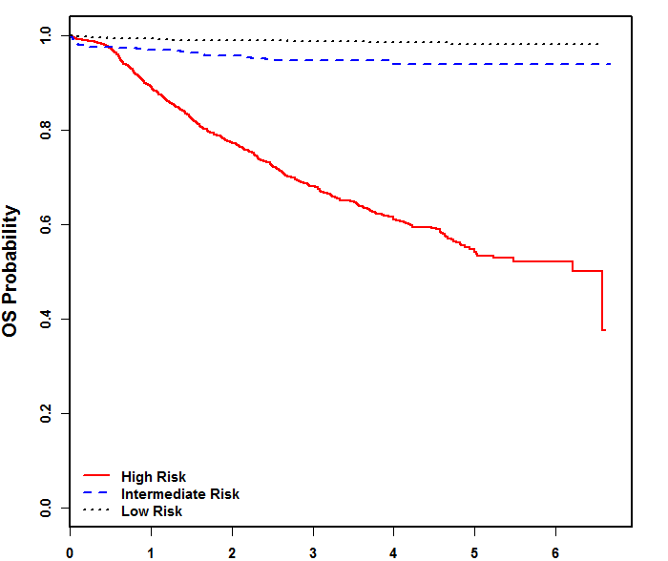
Risk stratification by prognostic factors
Low Risk
  INSS Stage 1, 2, 4s; INRGSS L1, MS
  Any age (4s/MS < 18 mos)
  No MYCN amplification
Intermediate
  INSS Stage 3, INRGSS L2
  INSS Stage 4, INRGSS M AND age < 18 months
  No MYCN amplification
  Age and histology important components of outcome
High Risk
  MYCN amplification
  INSS Stage 4, INRGSS M AND age ≥ 18 months; or 12-18 months with unfavorable histology or genomics
EFS by NBL Prognostic Group
Courtesty Children’s Oncology Group
10% of childhood cancer mortality
Copyright © 2019 by ASPHO

Slide 20
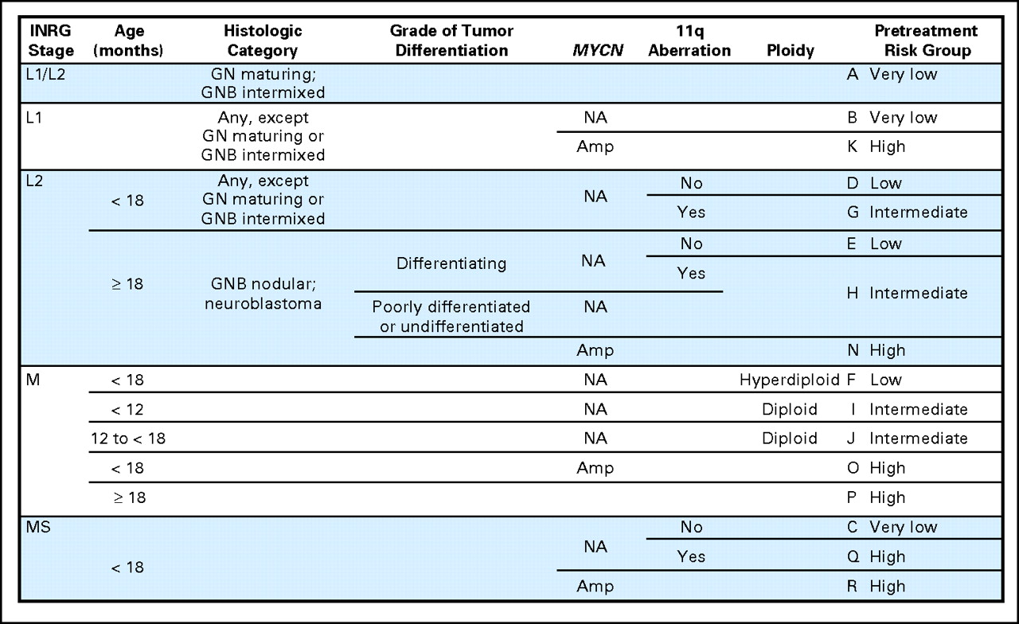
International Neuroblastoma Risk Group (INRG) Consensus Pretreatment Classification schema
Reprinted with permission. © (2009) American Society of Clinical Oncology. All rights reserved. Cohn, S et al: J Clin Oncol, Vol.27 (2), 2009: 289-297
Copyright © 2019 by ASPHO
Notes:
Fig 2. International Neuroblastoma Risk Group (INRG) Consensus Pretreatment classification schema. Pretreatment risk group H has two entries. 12 months 365 days; 18 months 547 days; blank field “any”; diploid (DNA index 1.0); hyperdiploid (DNA index 1.0 and includes near-triploid and near-tetraploid tumors); very low risk (5-year EFS 85%); low risk (5-year EFS75% to85%); intermediate risk (5-year EFS 50% to 75%); high risk (5-year EFS 50%). GN, ganglioneuroma; GNB, ganglioneuroblastoma; Amp, amplified; NA, not amplified; L1, localized tumor confined to one body compartment and with absence of image-defined risk factors (IDRFs); L2, locoregional tumor with presence of one or more IDRFs; M, distant metastatic disease (except stage MS); MS, metastatic disease confined to skin, liver and/or bone marrow in children 18 months of age (for staging details see text and Monclair et al14); EFS, event free survival.

Slide 21
Neuroblastic tumors
Basic Science and Pathophysiology
Epidemiology and Risk Assessment
Diagnosis
Management and Treatment
Copyright © 2019 by ASPHO

Slide 22
Clinical findings of neuroblastoma
Heterogenous disease with presentation ranging from coincidental finding to symptoms based on site of primary or metastatic disease
Symptoms associated with primary site of disease or nodal metastatic disease
  Neck Mass
  Abdominal Distension (35%)
  Horner syndrome (stellate ganglion)
  Genito-urinary symptoms
  Neurologic abnormalities
    Paralysis
  Hypertension
Symptoms associated with metastatic disease
  Ill-appearing, fever
  malaise, irritability
  weight loss, anorexia
Bone or Marrow metastases
  Pain: ill-defined (40%)
  Proptosis; “Raccoon Eyes”
Respiratory distress
  Restrictive disease due to liver enlargement/mass
  Effusions (lymphatic or malignant)
Skin nodules
Copyright © 2019 by ASPHO

Slide 23
Syndromes associated with neuroblastic tumors
Opsoclonus Myoclonus Ataxia Syndrome (OMAS)
  Occurs in approximately 4% NB diagnoses
  Myoclonic jerking and random eye movement, with or without cerebellar ataxia
  Associated with favorable NB features
  Long term neurologic and cognitive deficits, including psychomotor retardation
Kerner-Morrison Syndrome
  Tumor secretes Vasoactive Intestinal Peptide (VIP) causing intractable secretory diarrhea
  Tumor resection reduces secretion
Copyright © 2019 by ASPHO

Slide 24
Imaging modalities to determine the locoregional extent and metastatic spread of neuroblastoma
Anatomic imaging: CT / MRI scan (spine)
  Primary and nodal metastatic sites
Radiolabelled-metaiodobenzylguanidine (I-123 MIBG)
  Norepinephrine transporter present in 90% of neuroblastoma tumors resulting in update of MIBG
  FDG PET if tumor is MIBG non-avid
  Tc99 can be used at diagnosis but no longer used in evaluation of response
Copyright © 2019 by ASPHO

Slide 25
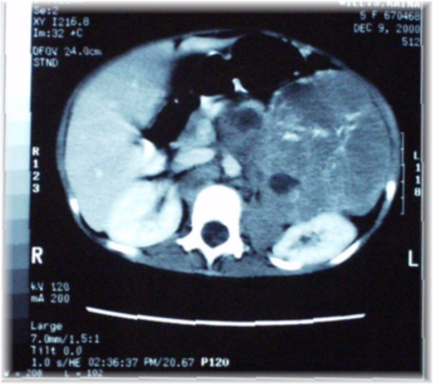
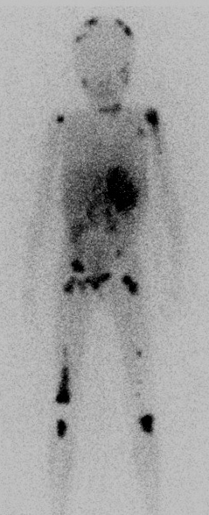
Diagnostic Imaging
CT adrenal primary
I123-MIBG
FDG-PET
Copyright © 2019 by ASPHO

Slide 26
Laboratory/pathology studies to determine diagnosis and metastatic spread of neuroblastoma
Tumor Biopsy
  Histologic grading
  Tumor genetic analysis
Bilateral Bone Marrow aspirate and biopsy
Elevated serum or urine catecholamines metabolites (homovanillic acid (HVA) and vanillymandelic acid (VMA))
  Secreted by 90% of neuroblastoma tumors
  Diagnosis of neuroblastoma can be made if elevated VMA/HVA AND bone marrow pathology that is consistent with neuroblastoma
Nonspecific markers: elevated neuro—specific enolase (NSE), ferritin, lactic dehydrogenase (LDH)
Copyright © 2019 by ASPHO

Slide 27
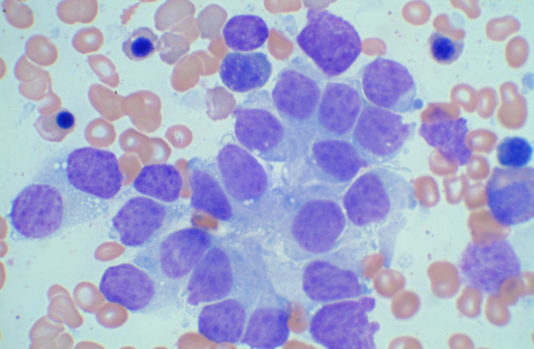
Neuroblastoma in bone marrow
Neuroblasts individually are small round cells
  Often (but not always) larger than small lymphocytes.
Cohesive clumps (5 or more cells) of various sizes and can take on polygonal shape
  HOMER-WRIGHT rosette formation
  “paving stone pattern”
NBL cells may also be found individually without forming clusters or nests (“leukemic pattern”).
immunohistochemistry staining (S100, CD56, PGP9.5)
Copyright © 2019 by ASPHO

Slide 28
Neuroblastic Tumors
Basic Science and Pathophysiology
Epidemiology and Risk Assessment
Diagnosis
Management and Treatment
Copyright © 2019 by ASPHO

Slide 29
Treatment for LOW RISK neuroblastoma
EFS/OS > 90%
Surgery mainstay of therapy
  Resection without damage to normal organs
    Delayed surgery for symptomatic INSS 4s/INRGSS MS
    Complete resection not mandatory
Observation alone without biopsy
    Infants with small Stage 1/L1 adrenal tumors
    Ongoing trials to assess observation for additional non-adrenal small L1 tumors
Chemotherapy for acute life/organ threatening symptoms or recurrence
Radiation for acute life/organ threatening symptoms
Copyright © 2019 by ASPHO

Slide 30
Treatment for INTERMEDIATE RISK Neuroblastoma
EFS >85%/OS > 90%
Surgery
  Upfront biopsy for genetic and histology data
  Delayed resection to achieve ≥50% reduction primary tumor size; Complete resection NOT mandatory
Chemotherapy Multi-agent; 2 – 8 cycles
  Vincristine, carboplatin, cyclophosphamide, doxorubicin
  Duration based on response: ≥50% reduction primary tumor and resolution of metastatic disease
  Longer duration if unfavorable histology, tumor SCA or tumor diploid (at least 4, up to 8 if combined with Stage 4/INRGSS M disease)
Radiation
  Reserved for acute life/organ threatening symptoms
Copyright © 2019 by ASPHO

Slide 31
Treatment for HIGH RISK neuroblastoma
5 year EFS ≈ 50%
Surgery
Surgery
SCT
RA +
Anti-GD2 Ab and cytokines
XRT
PBSC (BM) Harvest
PBSC Infusion
Induction:
Multi-Agent Chemotherapy;
Stem Cell Collection;
Surgery
Consolidation:
High dose chemotherapy and autologous PBSC rescue; External Beam Radiotherapy
Post-Consolidation:
Biologic Response
Modifier (isotretinoin=RA);
anti-GD2 Immunotherapy
Copyright © 2019 by ASPHO

Slide 32
Role of biologic response modifiers in the treatment of minimal residual neuroblastoma
ANBL0032: anti-GD2 Immunotherapy
improves EFS and OS
CCG 3891: randomized trial of 13 cis Retinoic acid (RA, isotretinoin) post-consolidation therapy
Post-consolidation use of RA improved EFS compared to no therapy
RA+antiGD2; 2 yr EFS: 66±5%
Event free survival
RA only; 2 yr EFS: 46 ±5%
Matthay, N Eng J Med, 1999
Time (years) from enrollment
N Eng J Med, Yu, A, Gilman, A., Fevzi O, et al, Anti-GD2 Antibody with GM-CSF, Interleukin-2, and
Isotretinoin for Neuroblastoma, Vol 363:1324-1334. Copyright © (2010)
Massachusetts Medical Society. Reprinted with permission from Massachusetts
Medical Society
Copyright © 2019 by ASPHO

Slide 33
Role of surgery in the treatment of neuroblastoma
Biopsy to confirm diagnosis and biologic factors
Primary tumor resection to achieve 50% reduction in tumor for patients with Low or Intermediate risk
Primary tumor complete resection for patients with High risk disease
Organ sparing goal
Copyright © 2019 by ASPHO

Slide 34
Role of irradiation in the treatment of neuroblastoma
Low or Intermediate risk disease
  Limited to emergent management of life/organ threatening symptoms
High risk disease
  Mandatory radiation to primary tumor (2160cGy)
    volume = pre-surgical tumor + margin
    boost to residual gross tumor being studied
  Metastatic soft tissue and bone sites that persist at end induction
  Delivered after high dose chemotherapy and PBSC rescue
Copyright © 2019 by ASPHO

Slide 35
Neuroblastoma treatment strategies
Copyright © 2019 by ASPHO

Slide 36
International Neuroblastoma Response Criteria
Response | Criteria
Complete Response (CR) | No evidence of primary tumor or metastases, HVA/VMA normal
Very Good Partial Response (VGPR) | Greater than 90% reduction of primary tumor volume; no metastatases, no new bone lesions, all pre-existing lesions improved on bone scan; HVA/VMA normal
Partial Response (PR) | Fifty-90% reduction of primary tumor volume; ≥50% reduction in measurable metastases;> 50% decrease in number of bone sites; 0-1 bone marrow samples with tumor
Mixed Response (MR) | Greater than 50% reduction of any measurable lesion with, < 50% reduction in any other site; no new lesions; <25% increase in any existing lesion
No Response (NR) | No new lesions; <50% reduction but <25% increase in any existing lesion
Progressive Disease (PD) | Any new lesion or increase of a measurable lesion by >25%; previous negative marrow positive for tumor
Brodeur; J Clin Oncol 1993
Copyright © 2019 by ASPHO

Slide 37
Revised INRC based on 3 distinct components
 | PRIMARY TUMOR | METASTATIC: SOFT TISSUE/BONE | METASTATIC: BONE MARROW | OVERALL RESPONSE integrates all 3
CT/MRI (soft tissue sites) | Primary site measured using single measurement (RECIST longest dimension) | Soft tissue sites (non-continguous) measured using single LD or sum of LD (RECIST) | Morphology (Immunocytology and Biopsy)
MIBG (FDG-PET for MIBG non-avid tumors) | Separate evaluation for primary site uptake | Scored by lesions present in designated anatomic sectors
Park; J Clin Oncol 2017
Copyright © 2019 by ASPHO
Notes:
2012 the NCI sponsored a Clinical Trials Planning meeting to develop revisions to the INRC
> 45 investigators from 13 countries participated in this work

Slide 38
INRC rev2
VMA/HVA levels are not incorporated into response assessment
Functional imaging (I123-MIBG or FDG-PET) incorporated to assess response in bone/bone marrow disease
Semi-quantification of bone marrow disease to assess response
Very Good Partial Response and Mixed Response no longer used
Minor Response captures response in metastatic sites but stable disease in primary tumor
Copyright © 2019 by ASPHO

Slide 39
INRC Overall Response (Revision 2)
Response | Criteria
Complete Response | All components meet criteria for CR
Partial Response | PR in at least one component and all other components are either CR, MD (Bone marrow), PR or Not involved; no component with SD or PD
Minor Response | PR or CR in at least one component but at least one other component with SD; no component with PD
Stable Disease | SD in one component with no better than SD or NI in any other component; no component with PD
Progressive Disease (PD) | Any component with PD
Copyright © 2019 by ASPHO

Slide 40
Primary Tumor
Response | Anatomical Imaging + MIBG (PET) Imaging
Complete Response | <10 mm residual soft tissue at primary site, AND complete resolution of MIBG or FDG-PET uptake (for MIBG non-avid tumors) (at primary site)
Partial Response | ≥30% decrease in longest dimension (LD) of primary site MIBG or FDG-PET uptake (at primary site) stable, improved or resolved
Progressive Disease | >20% increase in longest diameter, AND a minimum absolute increase of 5 mm in longest dimension
Stable Disease | Not CR, PR or PD
Copyright © 2019 by ASPHO
Notes:
¹not for use in assessment of metastatic sites
² used for MIBG non-avid tumors
³ a mass that has not meet PD measurement criteria but has fluctuating
MIBG avidity will not be considered progressive disease.
Retrospective review of 229 cases high risk NBL published by Bagatell et all in JCO 2015 demonstrated no statistical difference in outcome when comparing 3-D measurements versus single LD (RECIST)

Slide 41
Metastatic Soft Tissue/Bone Response
Response | Anatomical Imaging + MIBG (PET) Imaging
Complete Response | Resolution of all sites of disease defined as: Soft tissue mass <10 mm AND Lymph nodes identified <15 mm, AND No MIBG uptake or FDG-PET uptake
Partial Response | ≥30% decrease in sum of diameters of non-primary lesions, AND: Non-target lesions stable or smaller in size AND No new lesions AND ≥50% reduction in MIBG absolute score or in number of FDG-PET avid lesions
Progressive Disease | New MIBG or FDG-PET avid soft tissue or bone lesion or biopsy proven; >20% increase in size AND a minimum absolute increase of 5 mm in sum of diameters of target soft tissue lesions; Relative MIBG score ≥1.2
Stable Disease | All others
Copyright © 2019 by ASPHO
Notes:
Relative Score = MIBG score/ reference score

Slide 42
Bone Marrow
Response | Cytology/Histology
Complete Response | Bone marrow with no tumor infiltration upon reassessment, independent of baseline tumor involvement
Progressive Disease | No tumor infiltration that becomes >5% upon reassessment; Tumor infiltration increases by >2 fold and has >20% tumor infiltration
Minimal Disease | ≤5 % tumor infiltration and remains >0-≤5%; No tumor infiltration that becomes ≤5%; >20% tumor infiltration that has >0-≤5%
Stable DIsease | >5% tumor infiltration that remains > 5% tumor infiltration upon reassessment but not CR, MD or PD
Copyright © 2019 by ASPHO

Slide 43
Complications and late effects of neuroblastoma treatment
Surgical:
  Organ removal or damage (renal)
  Neural damage
Radiation: organ dysfunction (renal, heart, hepatic, lungs, ovaries, pituitary, neurocognitive), altered musculoskeletal growth, infertility; secondary malignancy
Chemotherapy: Ototoxicity (platinum); Cardiac toxicity (anthracycline); Infertility (alkylator); Secondary malignancy (alkylator, etoposide)
Biologic therapy: Decreased bone density (isotretinoin)
Copyright © 2019 by ASPHO

Slide 44
Pheochromocytoma and Paraganglioma (PPGLs)
Basic Science and Pathophysiology
Epidemiology and Risk Assessment
Diagnosis
Management and Treatment
Copyright © 2019 by ASPHO

Slide 45
Pheochromocytoma and Paraganglioma (PPGLs)
Neuroendocrine tumors arising from either chromaffin cells of sympathetic tissue in the adrenal or extra-adrenal abdominal locations (sympathetic PPGLs) or from parasympathetic tissue in the thorax or head and neck (parasympathetic PPGLs)
Sympathetic PPGL
  Aberrant section of norepinephrine and epinephrine
  80% develop in the adrenal medulla; 20% tumors develop in the prevertebral and paravertebral sympathetic ganglia of the chest, abdomen, and pelvis
Parasympathetic PPGLs
  Rarely secrete catecholamines (4%)
  Arise in the neck or at the base of the skull region along the glossopharyngeal and vagal nerves
Benign or malignant ( 10% of pheochromocytomas and 25% of PGL are malignant)
Copyright © 2019 by ASPHO

Slide 46
Molecular subtypes
Pseudohypoxia: mutations involving in overexpression of vascular endothelial growth factor (VEGF) and impaired DNA methylation leading to increased vascularization
Wnt-signaling pathway: activating mutations of Wnt-signaling pathway (Wnt receptor signaling and Hedgehog signaling) secondary to somatic mutations of CSDE1 (Cold shock domain containing E1) and MAML3(Mastermind like transcriptional coactivator 3) genes
Kinase-signaling pathway: abnormal activation of kinase signaling including PI3Kinase/AKT, RAS/RAF/ERK, and mTOR pathways
Copyright © 2019 by ASPHO

Slide 47
Biochemical phenotypes
Noradrenergic
  Elevated norepinephrine and normetanephrine levels; molecularly classified as molecular pseudohypoxia-related tumors
  Germline von Hippel-Lindau (VHL), succinate dehydrogenase (SDH) type A, B, C, or D, fumarate hydratase (FH), malate dehydrogenase type 2 (MDH2), and endothelial pas domain protein 1 (also known as hypoxia-inducible factor type 2A) (EPAS1/HIF2A) genes.
Adrenergic
  Secrete metanephrine; molecularly classified as kinase signaling-related tumors
  Located in adrenal, germline mutations in RET, NF1, or TMEM127
Dopaminergic
  Secrete dopamine with or without mild increase in norepinephrine (normetanephrine)
  Head and Neck PPGLs
  Metastatic disease, especially related to germline SDHB and SDHD mutations
Copyright © 2019 by ASPHO

Slide 48
Paraganglioma and Pheochromocytoma
Basic Science and Pathophysiology
Epidemiology and Risk Assessment
Diagnosis
Management and Treatment
Copyright © 2019 by ASPHO

Slide 49
Epidemiology and Risk Assessment
Rare tumor – annual incidence approximately 0.8 per 100,000 person-years
At least 40% have associated genetic cause (as much as 80% of pediatric patients) with at least 20 known susceptibility genes
Genetic testing should be performed in pediatric patients
Independent risk factors for metastatic disease: presence of SDHB germline mutation, extra-adrenal location, size of primary tumor > 5 cm (in SDHB-related PPGLs over 3.5 cm), younger age of initial diagnosis of PPGL and elevated 3-methoxytyramine (MT) levels
Copyright © 2019 by ASPHO

Slide 50
Paraganglioma and Pheochromocytoma
Basic Science and Pathophysiology
Epidemiology and Risk Assessment
Diagnosis
Management and Treatment
Copyright © 2019 by ASPHO

Slide 51
Imaging to define local extent and metastatic disease of PPGLs
Diagnosis is based on documentation of catecholamine excess by biochemical testing and then localization of the tumor by imaging with CT or MRI
Measurements of fractionated metanephrine (i.e. normetanephrine and metanephrine measured separately) in urine or plasma
¹⁸F-FDOPA or ⁶⁸Ga DOTATATE scanning is preferred functional modality for metastatic disease; or (18)F-FDG PET
  metastasize to lungs, liver, bones, and lymph nodes
(123)I-MIBG SPECT if considering MIBG therapy for metastatic disease
Copyright © 2019 by ASPHO

Slide 52
Clinical findings
Pain or nerve paralysis (head and neck)
Catecholamine release
  Classic symptom triad of headache, diaphoresis and tachycardia in the setting of hypertension.
  Hypertension is the most common sign and may be sustained or paroxysmal
  Headache occurs in up to 90% of patients
  Hypotension (excessive stimulation of beta adrenoreceptors by elevated levels of epinephrine), postural hypotension or alternating episodes of high and low blood pressure can also occur
  Anxiety, panic attacks
Copyright © 2019 by ASPHO

Slide 53
Paraganglioma and Pheochromocytoma
Basic Science and Pathophysiology
Epidemiology and Risk Assessment
Diagnosis
Management and Treatment
Copyright © 2019 by ASPHO

Slide 54
Treatment
Surgical excision of the tumor
Pre-operative medical management
  antihypertensive medications, preferentially alpha- followed by beta-adrenoceptor blockade for 7-14 days to prevent perioperative cardiovascular complications
  maximize water and salt intake to maintain adequate intravascular volume
Copyright © 2019 by ASPHO

Slide 55
Treatment of metastatic disease
Patients with metastatic or unresectable (advanced) pheochromocytoma or paraganglioma (PPGL) have poor prognoses
Chemotherapy (cyclophosphamide, vincristine, and dacarbazine)
High-specific-activity I-131 MIBG offers multiple benefits, including sustained blood pressure control and tumor response in PPGL patients
Molecularly targeted therapy: sunitinib (tyrosine kinase inhibitor) and everolimus (mTOR inhibitor)
Copyright © 2019 by ASPHO

Slide 56
Renal Tumors
Basic Science and Pathophysiology
Epidemiology and Risk Assessment
Diagnosis
Management and Treatment
Copyright © 2019 by ASPHO

Slide 57
Pathologic subtypes of renal tumors
Wilms
Clear Cell Sarcoma of the Kidney
Rhabdoid Tumor
Renal Cell Carcinoma (> 15 yo)
Congenital Mesoblastic Nephroma
Renal Medullary Carcinoma (Sickle cell disease)
Copyright © 2019 by ASPHO

Slide 58
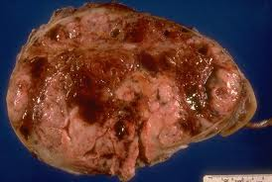
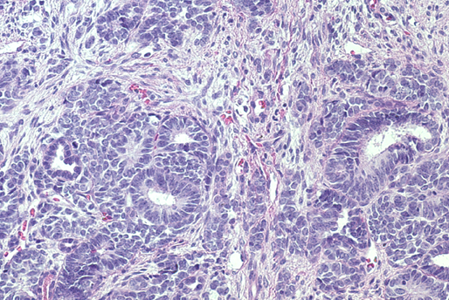
Wilms Tumor
Microscopically resembles developing embryonic renal tissue
Classic pathologic triad:
  Glomeruli and tubules (epithelial)
  Blastema (undifferentiated)
  Stroma
Tumor spread
  Lymph nodes, lungs, liver
  Bone rare
Copyright © 2019 by ASPHO

Slide 59
Nephroblastomatosis
Nephroblastomatosis = Nephrogenic rests in unilateral or contralateral kidney
Histologically can not be distinguished from Wilms
If present at time of Wilms diagnosis: At increased risk for recurrence
Require surveillance with serial US until age of 8-10 years of age
Copyright © 2019 by ASPHO

Slide 60
Somatic genetic abnormalities in Wilms tumor
Other genes associated:
Chromosome 1q
ch 16q and ch 1p
CACNA1E
SKCG-1
MYCN
TP53
PTCH1
DICER1
WT1
15%
WTX
30%
Unknown or Other
25%
WT2
30%
Copyright © 2019 by ASPHO

Slide 61
Wilms tumor genetics
WT1 (Wilms Tumor 1) (ch11p13)
  Incidence of germline mutations ≈ 10%
    WAGR syndrome, Denys-Drash syndrome or Frasier syndrome
    Genitourinary anomalies, including hypospadias and cryptorchidism
  Bilateral Wilms tumor
  Unilateral Wilms tumor with nephrogenic rests in the contralateral kidney
  Stromal and rhabdomyomatous differentiation.
Copyright © 2019 by ASPHO

Slide 62
Wilms tumor genetics
  WT2 (imprinted region of chromosome 11p15.5)
    Incidence germline mutations ≈ 8%
    Beckwith-Wiedemann syndrome
    Germline epigenetic or genetic changes at the 11p15.5 without any overgrowth manifestations
WTX (X chromosome)
    plays a role in normal kidney development
    Inactivated in 30% Wilms but germline mutations not observed
Copyright © 2019 by ASPHO

Slide 63
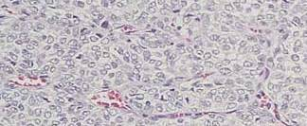
Clear Cell Sarcoma
2nd most common pediatric renal tumor
Histology: cords and nests of pale-stained tumor cells with abundant extracellular matrix separated by a network of fine capillary arcades.
  Can be confused with Wilms
Propensity to metastasize
  bone, brain, and soft tissue
High recurrence rate and death rate
Copyright © 2019 by ASPHO

Slide 64
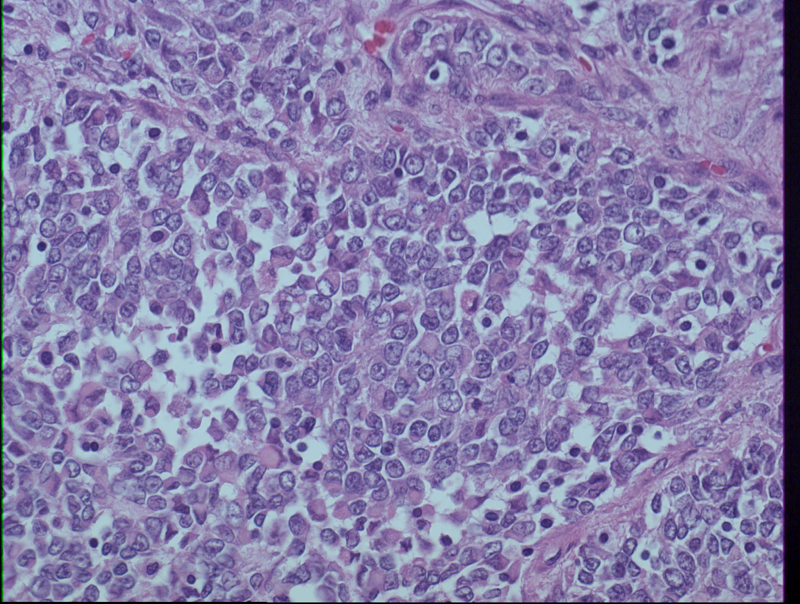
Rhabdoid Tumor
Most commonly encountered in infants under 1 year, rare > 5 yo
Frequent coexistence of PNET of the CNS
Lack of INI1 expression
  Somatic or Germline
Often metastatic to lungs, abdomen, lymph nodes, liver, bone and brain at diagnosis
Clinically aggressive tumor, extremely poor prognosis
Copyright © 2019 by ASPHO

Slide 65
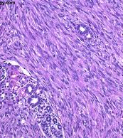
Congenital Mesoblastic Nephroma
Usually detected within the first year of life or prenatally
Histology: classic and cellular subtypes.
Clinical symptoms: hypertension and elevated concentrations of calcium and renin
The risk for recurrence is associated with the presence of a cellular component and with stage
Copyright © 2019 by ASPHO

Slide 66
Renal Tumors
Basic Science and Pathophysiology
Epidemiology and Risk Assessment
Diagnosis
Management and Treatment
Copyright © 2019 by ASPHO

Slide 67
Renal Tumors of Childhood
Account for 7% of all childhood cancers
Nephroblastoma (Wilms) – most common renal tumor of childhood (95%)
Renal Cell Carcinoma most common renal tumor in patients 15-19 years of age
Copyright © 2019 by ASPHO
Notes:
The incidence of Wilms tumor is 7.1 cases per 1 million children younger than 15 years. Approximately 500 cases of Wilms tumor are diagnosed in the United States each year. The incidence is substantially lower in Asians. The male to female ratio in unilateral cases of Wilms tumor is 0.92:1.00, but in bilateral cases it is 0.60:1.00. The mean age at diagnosis is 44 months in unilateral cases of Wilms tumor and 31 months in bilateral cases.[1,2] About 10% of children with Wilms tumor have an associated congenital malformation syndrome.

Slide 68
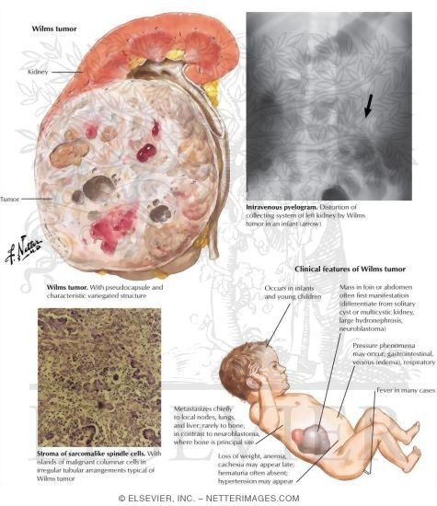
Epidemiology: Wilms Tumor
7.1 cases/1 million < 15 years; 500 cases in US annually
Ethnic incidence: African Americans highest, Asian lowest
Median age diagnosis: 43 months girls, 37 months boys
Female predominance, especially for bilateral
5-10% are bilateral
10% multifocal loci in solitary kidney
Netter, F, The Netter Collection of Medical Illustrations, © 2005–2018 Elsevier. All Rights Reserved.
Copyright © 2019 by ASPHO

Slide 69
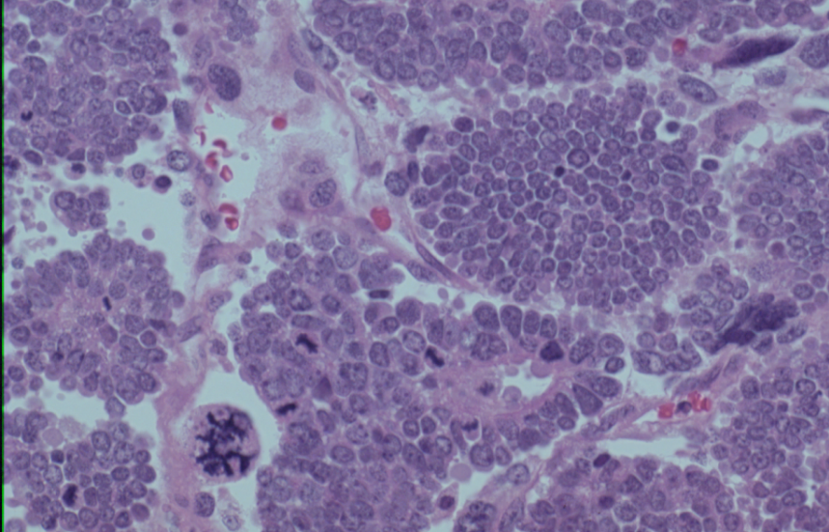
Wilms tumor histology is associated with prognosis
Anaplastic nuclear change (nuclear gigantism with multipolar polypoid mitotic figures)
Hyperchromasia
Distribution of anaplastic nuclear changes is a determinant of prognosis (focal vs diffuse)
Marker of increased resistance to chemotherapy but NOT increased tumor stage
Favorable Histology-92%; Anaplastic histology- 8%
Copyright © 2019 by ASPHO

Slide 70
Genetic Predisposition to Wilms – Overgrowth syndromes
Beckwith-Wiedemann Syndrome
  Loss of imprinting at ch 11p15 (WT2)
  Macroglossia, organomegaly, abdominal wall closure defects, hemi-hypertrophy, muscular hypertrophy, 5-10% develop Wilms tumor
Perlman Syndrome
  DIS3L2 inactivating mutations (disordered RNA metabolism)
  Fetal gigantism, visceromegaly, unusual face, bilateral renal hamartomas with nephroblastomatosis, and Wilms tumor
Copyright © 2019 by ASPHO
Notes:
WAGR: wilms, aniridia, GU malformations, mental retardation (WT1 or PAX6)
BWS: macroglossia, visceromegaly, abdominal wall closure defects, muscular hypertrophy, hemi-hypertrophy
Denys-Drash: nephropathy, male pseudhemaphroditism
Perlman: similar to BWS (macroglossia, organomegaly, facies)
WT1: transcription factor in 11p13, either mutations or deletions in gene (not usually sporadic)
WT2: second locus at 11p15 (LOH) in 40% of sporadic cases
It is the genetics and mutations of WT1 that are being studi

Slide 71
Wilms Genetic Predisposition - Overgrowth
Sotos Syndrome
  NSD1 (chromosome 5; protein function unknown)
  Overgrowth syndrome with facial, extremity and cognitive abnormalities, 2-3% develop Wilms
Simpson-Golabi-Behmel syndrome
  gycpican-3 X-linked genetic disorder (GPC3)
  Organomegaly, coarse facies, congenital heart disease, polydactyl, 7.5% develop Wilms
9q22.3 microdeletion syndrome
  PTCH1 deletion
  craniofacial abnormalities, craniosynostosis, hydrocephalus, macrosomia, learning disabilities, and Gorlin syndrome
Copyright © 2019 by ASPHO

Slide 72
Wilms Genetic Predisposition-Nonovergrowth
WAGR
  WT1 gene product is a transcription factor involved in both gonadal and renal development
  Wilms (50-100%), aniridia, GU malformations, mental retardation (ch11p13 LOH)
Denys-Drash Syndrome
  germline point mutation in the eighth or ninth exon WT1
  Nephropathy, male pseudohemaphroditism, 90% develop Wilms
Copyright © 2019 by ASPHO

Slide 73
Wilms Genetic Predisposition-Nonovergrowth
Familial (1.5 -2% of all Wilms cases)
  WT1 (11p13), FWT1 (17q), FWT2 (19q)
Bloom syndrome
  BLM
  short stature and being thinner than other family members, sun-sensitive skin changes
Li-Fraumeni syndrome
  TP53 or CHEK2 gene mutation
  Increased risk for breast cancer, osteosarcoma, soft tissue sarcoma, brain tumor, leukemia, adrenocortical carcinoma, and Wilms tumor
Copyright © 2019 by ASPHO

Slide 74
Wilms Genetic Predisposition-Nonovergrowth
Fanconi anemia with biallelic mutations in BRCA2 (FANCD1) or PALB2 (FANCN).
  BRCA2 and PALB2 play central roles in homologous recombination DNA repair
  increased risks of selected childhood cancers, including Wilms tumor
Trisomy 18
  Complex cardiac defects
Copyright © 2019 by ASPHO

Slide 75
Renal Cell Carcinoma Predisposition Syndromes
von Hippel-Lindau (VHL) disease
  autosomal dominant condition in which blood vessels in the retina and cerebellum grow excessively.
  deleted tumor suppressor gene on chromosome 3p26
Tuberous sclerosis
Familial RCC
  inherited chromosome 3 translocation
  Succinate dehydrogenase (SDHB, SDHC, and SDHD) mutation when associated with pheochromocytoma
Hereditary leiomyomatosis and RCC
  autosomal dominant susceptibility for development of cutaneous leiomyomas, early onset multiple uterine leiomyomas and an aggressive form of type 2 papillary renal cell cancer
Copyright © 2019 by ASPHO

Slide 76
Renal medullary carcinoma
Seen almost exclusively in individuals with sickle cell disease and sickle cell trait
Males predominance, affected in 66% of cases
Copyright © 2019 by ASPHO

Slide 77
Prognostic features of renal tumors
Stage of disease at diagnosis
Tumor size
  Infants with localized disease
Histopathologic features of the tumor
  Diffuse anaplasia (10% of Wilms); EFS 55%
  Rhabdoid tumor; EFS 30%
Molecular features of the tumor
  Tumor-specific loss of heterozygosity (LOH) for combined 1p and 16q predicts recurrence of FH Wilms tumor
    Stage I/II EFS 75%; Stage III/IV EFS 65%
Patient age (adolescents and young adults)
Bilateral disease (5 yr EFS 65%)
Copyright © 2019 by ASPHO

Slide 78
Renal Tumors
Basic Science and Pathophysiology
Epidemiology and Risk Assessment
Diagnosis
Management and Treatment
Copyright © 2019 by ASPHO

Slide 79
Clinical presentation of renal tumors
Usually presents as an asymptomatic upper abdominal mass noted by caregiver
Abdominal pain (40%)
Fever (20-30%)
Anemia (from bleeding into tumor)
Gross hematuria (from tumor extension into the renal pelvis) (25%)
Hypertension (from distortion of renal vasculature, renin excretion) (25%)
Hypercalcemia (rhabdoid tumors)
Copyright © 2019 by ASPHO

Slide 80
Congenital anomalies associated with Wilms tumor
Associated malformations occur in 10% of patients
Aniridia: 1.3%
  Hemi-hypertrophy: 1.9%
  GU malformations: 5.7%
  Malformations of any type: 12.7%
Isolated Hemihypertrophy
  5-6% develop Wilms tumor
Children with associated malformations are younger at diagnosis of Wilms tumor (31 m girls, 24 m boys)
Copyright © 2019 by ASPHO

Slide 81
Diagnostic imaging modalities to determine the local extent and metastatic spread of renal tumors
Anatomical imaging
  CT scan chest, abdomen, pelvis
  US to evaluate intravascular extension
Metastatic disease
  Chest CT (lung)
  Tc99 scan if clinical concern for metastatic bone disease or clear cell sarcoma
  Brain imaging (MRI) considered in patients with clear cell sarcoma or rhabdoid tumors
Copyright © 2019 by ASPHO

Slide 82
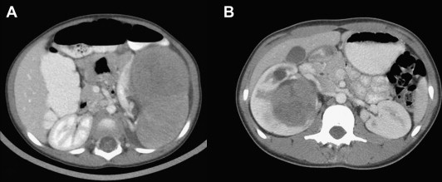
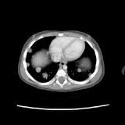
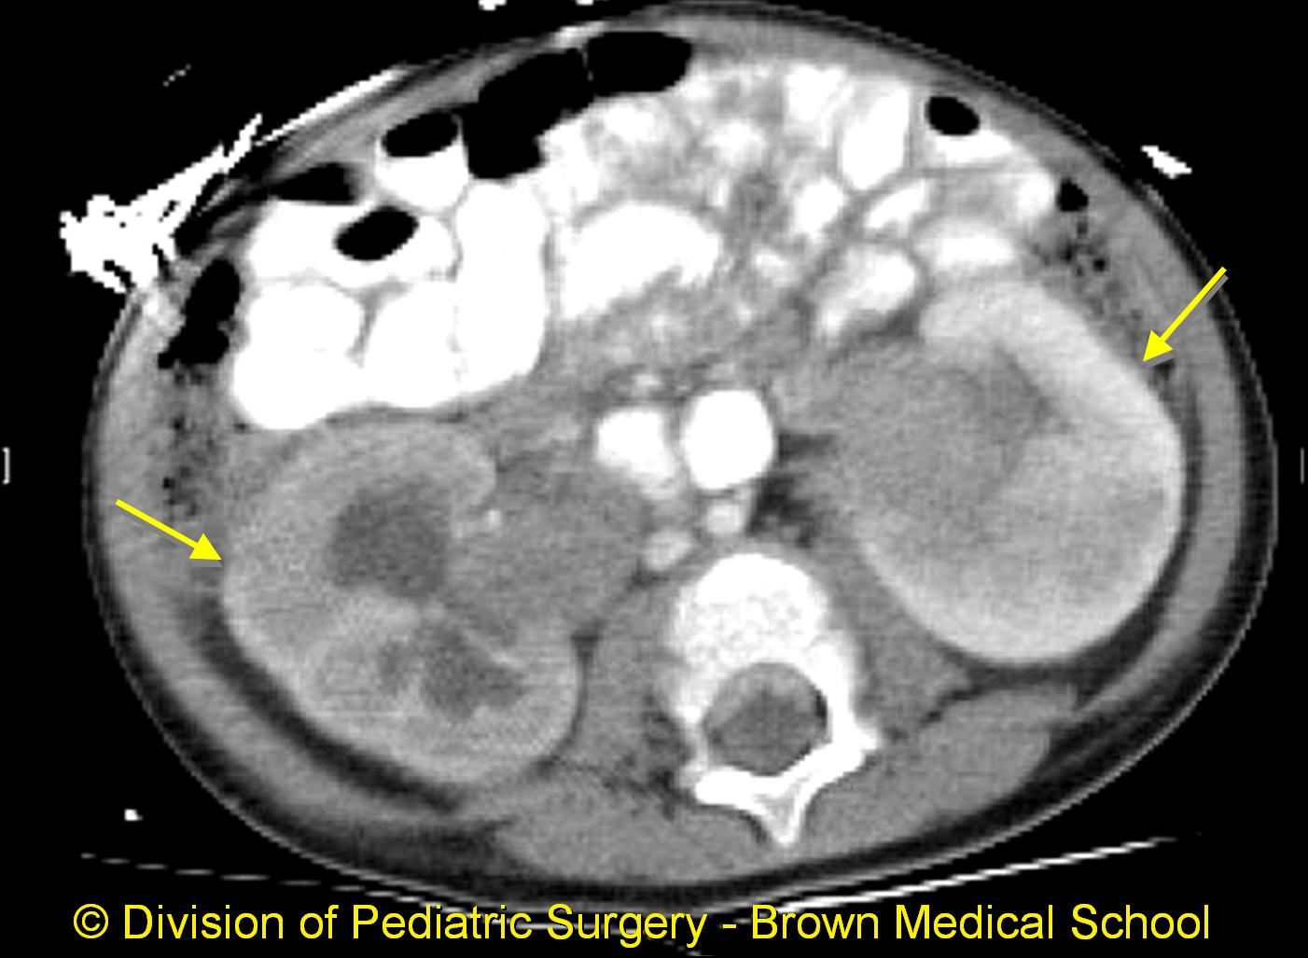
CT imaging to determine the extent and metastatic spread of renal tumors
Copyright © 2019 by ASPHO

Slide 83
Laboratory/pathology studies to determine the extent and metastatic spread of renal tumors
Bone marrow aspirate and biopsy for clear cell sarcoma
von Willebrand disease work-up optional
  About 1% to 8% of patients presenting with Wilms tumor have acquired von Willebrand disease, many asymptomatic.
  Reduced von Willebrand multimer plasma concentration.
Copyright © 2019 by ASPHO

Slide 84
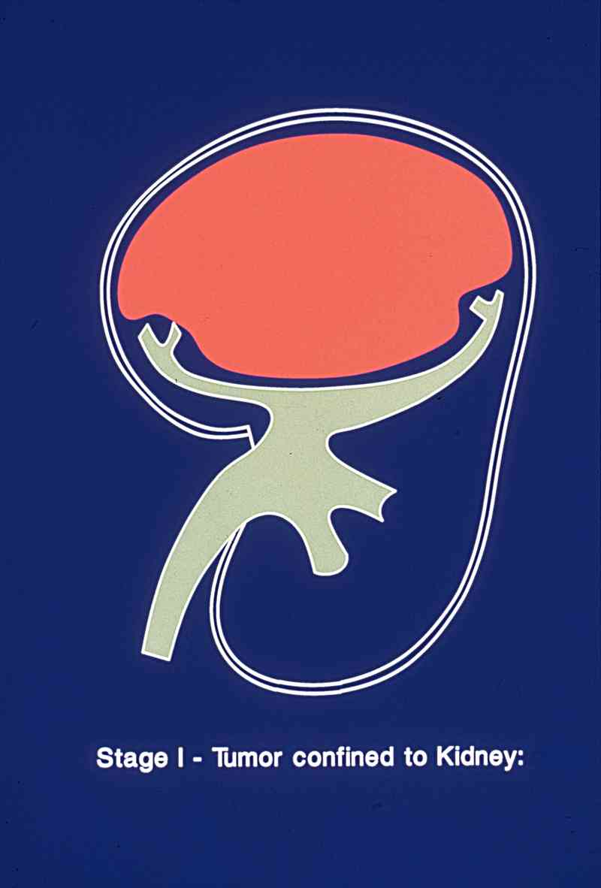
Stage I: Confined to the Kidney
Tumor is limited to the kidney and is completely resected.
The renal capsule is intact.
The tumor is not ruptured or biopsied before being removed.
No involvement of renal sinus vessels.
All lymph nodes sampled are negative.
40% of Wilms
Copyright © 2019 by ASPHO
Image courtesy of Susan Cohn

Slide 85
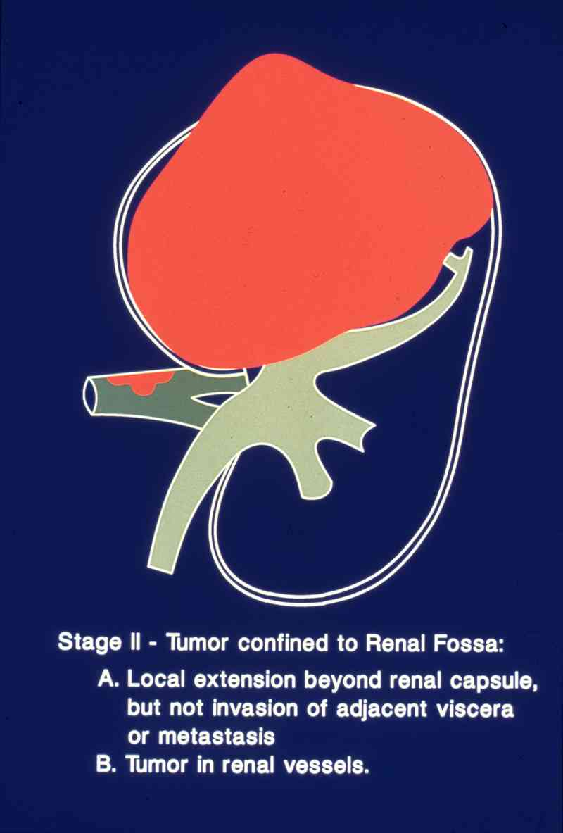
Stage II: Confined to the Renal Fossa
Completely resected tumor including enbloc resection of vascular extension.
There is regional extension of the tumor (i.e., penetration of the renal sinus capsule, or extensive invasion of the soft tissue of the renal sinus, extension into blood vessels outside of renal parenchyma).
All lymph nodes sampled are negative.
20% of Wilms
Copyright © 2019 by ASPHO
Image courtesy of Susan Cohn

Slide 86
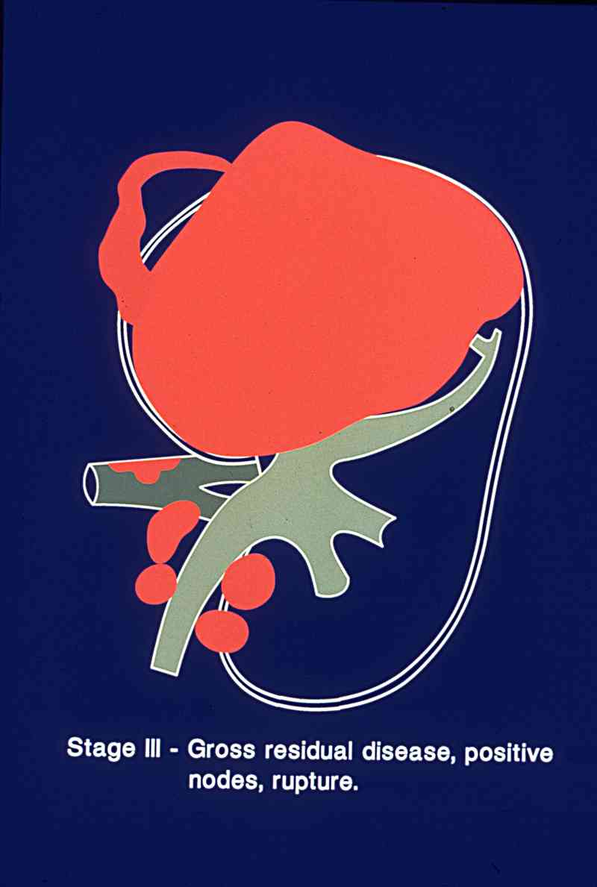
Stage III: Gross Residual Disease
Post-surgical residual tumor (gross or microscopic)
Lymph nodes in the abdomen or pelvis are involved by tumor.
The tumor penetrated through the peritoneal surface or peritoneal implants.
The tumor is not completely resectable, spills/ruptures or is biopsied before removal.
The tumor is removed in more than one piece (e.g., a tumor thrombus in the renal vein is removed separately from the nephrectomy specimen).
20% of Wilms
Copyright © 2019 by ASPHO
Image courtesy of Susan Cohn

Slide 87
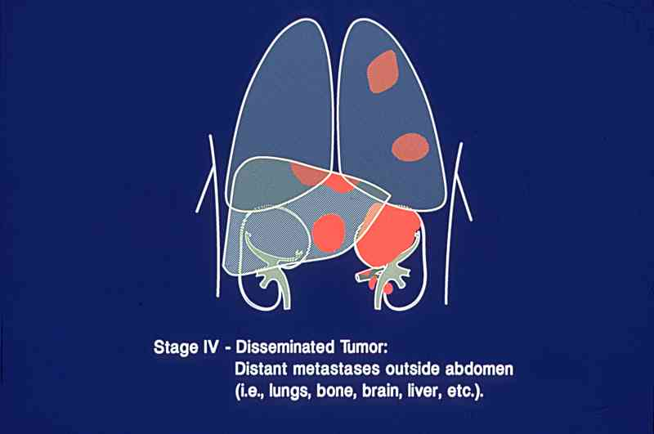
Stage IV: Disseminated Tumor
Hematogenous tumor spread
  Lungs, liver, bone, brain
Lymph node metastases outside the abdominopelvic region
10% of Wilms
Copyright © 2019 by ASPHO
Image courtesy of Susan Cohn

Slide 88
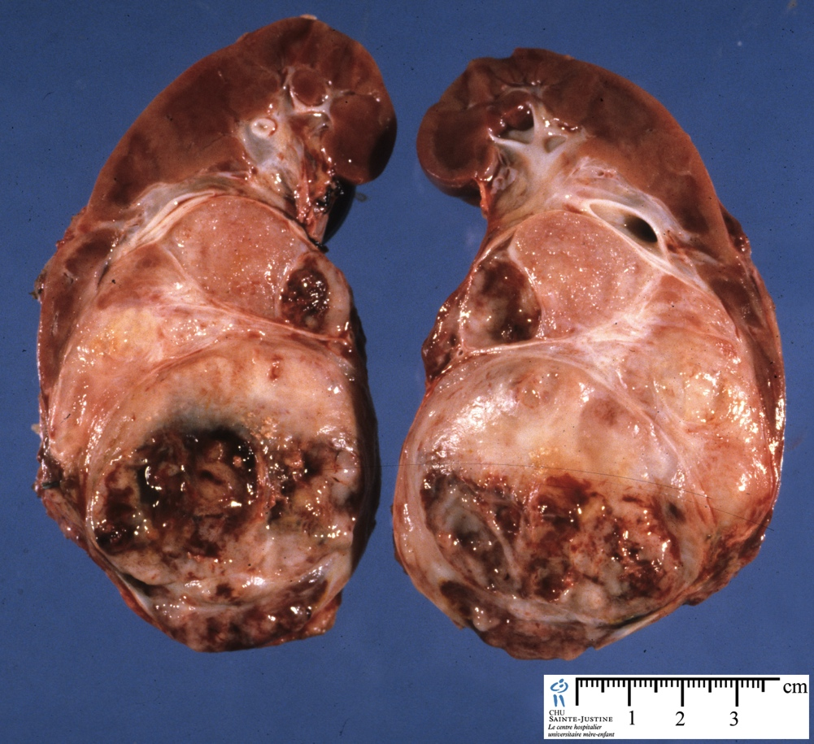
Stage V: Bilateral Tumor Involvement
5-10% of Wilms
More common with nephroblastomatosis or associated congenital malformations
Copyright © 2019 by ASPHO

Slide 89
SIOP Staging: post-chemotherapy
Copyright © 2019 by ASPHO

Slide 90
Renal Tumors
Basic Science and Pathophysiology
Epidemiology and Risk Assessment
Diagnosis
Management and Treatment
Copyright © 2019 by ASPHO

Slide 91
Evolution of Wilms Tumor Therapy
Survival %
(approximate)
surgery
NWTSG/SIOP
XRT
Copyright © 2019 by ASPHO
chemo

Slide 92
General Approach to Renal Tumor Therapy
Standard therapies established for majority of tumors (NWTS-5)
Initial nephrectomy followed by chemotherapy and, in some patients, radiation therapy
Survival
Toxicity
Copyright © 2019 by ASPHO

Slide 93
Tailoring therapy according to prognostic factors
Stage: Renal sparing surgery
  Stage V or diffuse hyperplastic perilobar nephroblastomatosis (DHPLN)
Genomic status
  Increase chemotherapy for FH with combined LOH 16q/1p
Metastatic response rate (lung metastases)
  Increase chemotherapy for slow response at Wk 6
Histology
  Increase chemotherapy for anaplasia and unfavorable renal tumors
Copyright © 2019 by ASPHO

Slide 94
Role of surgery in the treatment of renal tumors
Radical nephrectomy with lymph node sampling
  Avoid tumor rupture and assess tumor extent
  Hilar and periaortic lymph node sampling is appropriate even if the nodes appear normal
  Routine exploration of the contralateral kidney is not necessary
  The presence of gross hematuria, nonfunctioning kidney, or hydronephrosis suggests the tumor may extend into the ureter, and cystoscopy is recommended with en bloc resection if involved
Copyright © 2019 by ASPHO

Slide 95
Role of surgery in the treatment of renal tumors
Renal sparing surgery should be considered:
  Solitary functioning kidney
  Horseshoe kidney
  Predisposition to bilateral tumors
  Bilateral Wilms
Copyright © 2019 by ASPHO

Slide 96
Role of irradiation in the treatment of renal tumors
Post-operative flank irradiation to tumor bed (1080cGy)
  Stage III, Stage IV
  Focal or Diffuse Anaplasia
  Clear Cell Sarcoma - All stages
  Rhabdoid Tumor – All stages
Whole abdomen irradiation if spill outside of tumor bed
Whole lung irradiation for lung metastases
  Eliminate if full response by 6 weeks
Limited role of radiation therapy in renal cell carcinoma
Copyright © 2019 by ASPHO

Slide 97
Role of chemotherapy in the treatment of renal tumors
Chemotherapy initiated after primary nephrectomy
  Drugs and duration dependent on pathology, stage and tumor genetics
  Vincristine, dactinomycin, doxorubicin mainstay agents
  Additional agents added in settings of unfavorable prognosis
    Cyclophosphamide, etoposide, carboplatin
Limited role in treatment of renal cell carcinoma
Copyright © 2019 by ASPHO

Slide 98
Presurgical chemotherapy in the treatment of renal tumors
Synchronous bilateral Wilms tumor
Wilms tumor in a solitary kidney
Extension of tumor thrombus in the inferior vena cava above the level of the hepatic veins
Tumor not resectable (involves contiguous structures whereby the only means of removing the kidney tumor requires removal of the other structures, vascular extension)
Pulmonary compromise due to extensive pulmonary metastases
Copyright © 2019 by ASPHO

Slide 99
NWTS Regimen EE4A
Week 0 1 2 3 4 5 6 7 8 9 10 11 12 13 14 15 16 17 18
A A A A A A A
V V V V V V V V V V V* V* V*
Post surgical chemotherapy
A – Dactinomycin (DACT) (45 mcg/kg)
V - Vincristine (VCR) (0.05 mg/kg)
V* - Vincristine (0.067 mg/kg)
Post-operative radiotherapy is used only for Stage I and Anaplasia
Copyright © 2019 by ASPHO

Slide 100
NWTS Regimen DD4A
Week 0 1 2 3 4 5 6 7 8 9 10 11 12 15 18 21 24
A D+ A D+ A D A D A
V V V V V V V V V V V* V* V* V* V*
XRT
A- Dactinomycin (45 mcg/kg) V- Vincristine (0.05 mg/kg)
D- Doxorubicin (DOX) (1.0 mg/kg) V - Vincristine (0.067 mg/kg)
D+ - Doxorubicin (1.5 mg/kg)
XRT:1080 cGy to flank/abdomen
Whole abdomen for spill outside tumor bed
Whole lung for pulmonary mets
Copyright © 2019 by ASPHO

Slide 101
Chemotherapy Regimens
Regimen M: VCR/DACT/DOXO alternating with Cyclophosphamide/Etoposide x 31 wks
High Risk Renal (HRR): VCR/DOXO/Cyclophosphamide alternating with Cyclophosphamide/Etoposide/Carboplatin x 30 wks
Revised UH-2: HRR +VCR/Irinotecan x 30 wks
Copyright © 2019 by ASPHO

Slide 102
Histology
Favorable Histology
DD4A (no XRT)
EE4A
Focal Anaplasia or Diffuse Anaplasia
DD4A
+ Local XRT
Stage I
(> 2 years)
EE4A
< 2 years
Favorable Histology
Tumor weight <550g
*Irrespective of LOH status
Surgery alone; or VCR x 8 weeks; or EE4
Stage I
Limited to kidney
Completely resected
Renal capsule intact
No tumor invasion of veins/lymphatics
No metastatic disease
No prior biopsy
(+)LOH
(-)LOH
Copyright © 2019 by ASPHO
Notes:
Stage 1 >/= 2 or < 2 but with big tumor: No radiation was given, just increase in drugs; LOH isn’t available at start of treatment so everyone starts with EE4A and then escalate

Slide 103
Histology
Favorable Histology
DD4A
EE4A
Focal Anaplasia
DD4A
+ Local XRT
Stage II
Diffuse Anaplasia
HRR
+ Local XRT
EE4A
(+)LOH
(-)LOH
Stage II
Extends beyond kidney, but completely resected
Tumor penetrates renal capsule
Tumor in lymphatic or renal veins
No lymph node involvement
Copyright © 2019 by ASPHO
Notes:
No radiation was given if no anaplasia, just increase in drugs; LOH isn’t available at start of treatment so everyone starts with EE4A and then escalate

Slide 104
Histology
Favorable Histology
Regimen M
+Local XRT
DD4A
+Local XRT
Focal Anaplasia
DD4A
+ Local XRT
Stage III
Diffuse Anaplasia
HRR
+ Local XRT
DD4A + Local XRT
(+)LOH
(-)LOH
Stage III
Gross residual tumor post-op
Involved abdominal nodes
Peritoneal contamination
Biopsy before nephrectomy
Piecemeal resection
Copyright © 2019 by ASPHO
Notes:
Same here; start with DD4A and then escalate to M once LOH known; LOH should be included in focal anaplasia as well

Slide 105
Histology
Favorable Histology
Regimen M
+XRT
CR at Week 6
Focal Anaplasia
HRR
+ XRT
Stage IV
Diffuse Anaplasia
HRR , (?rUH-2)
+ XRT
DD4A
*Omit lung XRT
Regimen M
+ XRT to metastatic sites
DD4A +XRT
Stage IV
Spread beyond abdomen
Hematogenous metastases
(+)LOH
(-)LOH
Yes
No
Eliminate lung XRT if complete pulmonary response at Week 6 (and no other metastatic disease)
  The outcomes similar to previously reported outcomes for Stage IV disease treated with whole lung XRT.
Additional chemotherapy if persistent lung nodules at week 6 (slow response)
Copyright © 2019 by ASPHO
Notes:
Repeat: don’t have LOH at diagnosis so start with DD4A and then escalate to M

Slide 106
Management of mesoblastic nephroma
Nephrectomy (entire capsule) adequate therapy for most patients
Patients at increased risk of local and eventually metastatic recurrence if there was stage III disease (incomplete resection and/or histologically positive resection margin), cellular subtype, and age 3 months or older at diagnosis. Adjuvant chemotherapy may benefit
Adjuvant chemotherapy not needed for those < 2 months of age regardless of resection.
Copyright © 2019 by ASPHO

Slide 107
Treatment of recurrent Wilms tumor
FH Wilms tumor with relapse after only vincristine and/or dactinomycin
  30% of recurrences
Treatment: surgical excision when feasible, radiation therapy, and alternating courses of vincristine, doxorubicin, and cyclophosphamide; and etoposide and cyclophosphamide
Copyright © 2019 by ASPHO

Slide 108
Treatment of recurrent Wilms tumor
High risk (45-50%): FH Wilms tumor who relapse after therapy with three or more agents.
Very high risk (10-15%): Patients with recurrent anaplastic or blastemal-predominant Wilms tumor.
Treatment:
  Relapse after 3 drug (VAD): alternating courses of cyclophosphamide/etoposide and carboplatin/etoposide, surgery, and radiation therapy
  Anaplastic Tumors have very poor prognosis
    Ifosfamide/Carboplatin/Etoposide
    Autologous Hematopoietic Stem Cell Transplant
Copyright © 2019 by ASPHO

Slide 109
Complications and late effects of treatment
Cardiotoxicity
  NWTS 1-4: cumulative risk CHF 4.4% at 20 yrs
Second Malignancy
  1.6% 15 years after Wilms diagnosis
Hepatotoxicity
  VOD in about 3% with current therapy
  Radiation and dactinomycin
Pregnancy/fertility
  Infertility with whole abdominal radiation;
  Prematurity and increased risk of congenital anomalies with flank XRT
Renal dysfunction (nephrectomy, Stage V)
  Cumulative incidence of end-stage renal disease 3.1% for patients with bilateral tumors
Copyright © 2019 by ASPHO

Slide 110
Late effects of treatment
Musculoskeletal/Growth abnormalities
Liver dysfunction
Renal dysfunction (Bilateral Wilms Tumor)
Secondary malignancy
Copyright © 2019 by ASPHO

Slide 111
Thank you for your attention
Questions?
Copyright © 2019 by ASPHO

